Slide 1
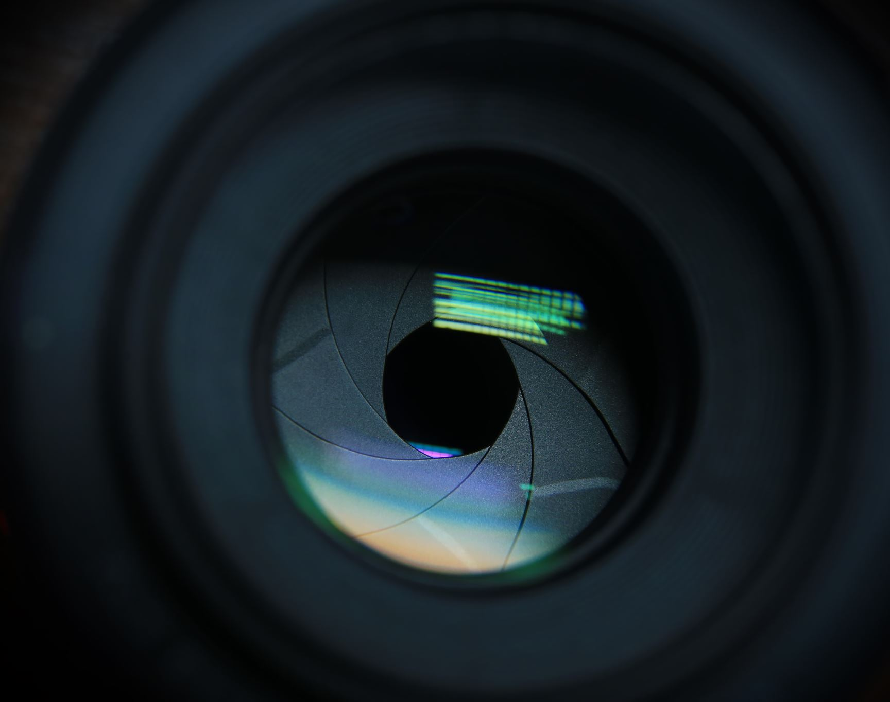
Image Classification with Coded Aperture
Overview, experiment results, and more

Slide 2

Experiments
Classify original MNIST images
1
Classify encoded MNIST images
2
Reconstruct encoded MNIST images, then classify from reconstructions
3
CNN with Sigmoid activation
CNN with NO activation

Slide 3
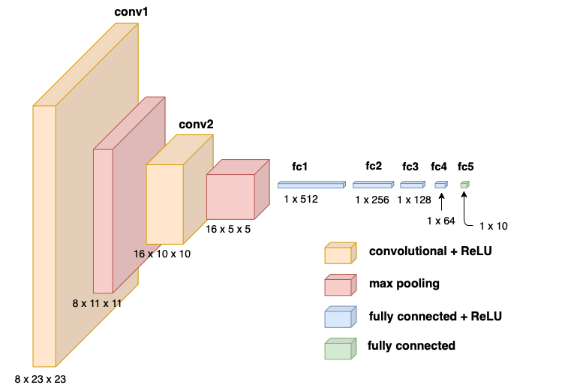
Classification Architecture
2 convolutional layers
2 max pooling layers
4 fully connected layers with ReLu activation
1 output layer

Slide 4
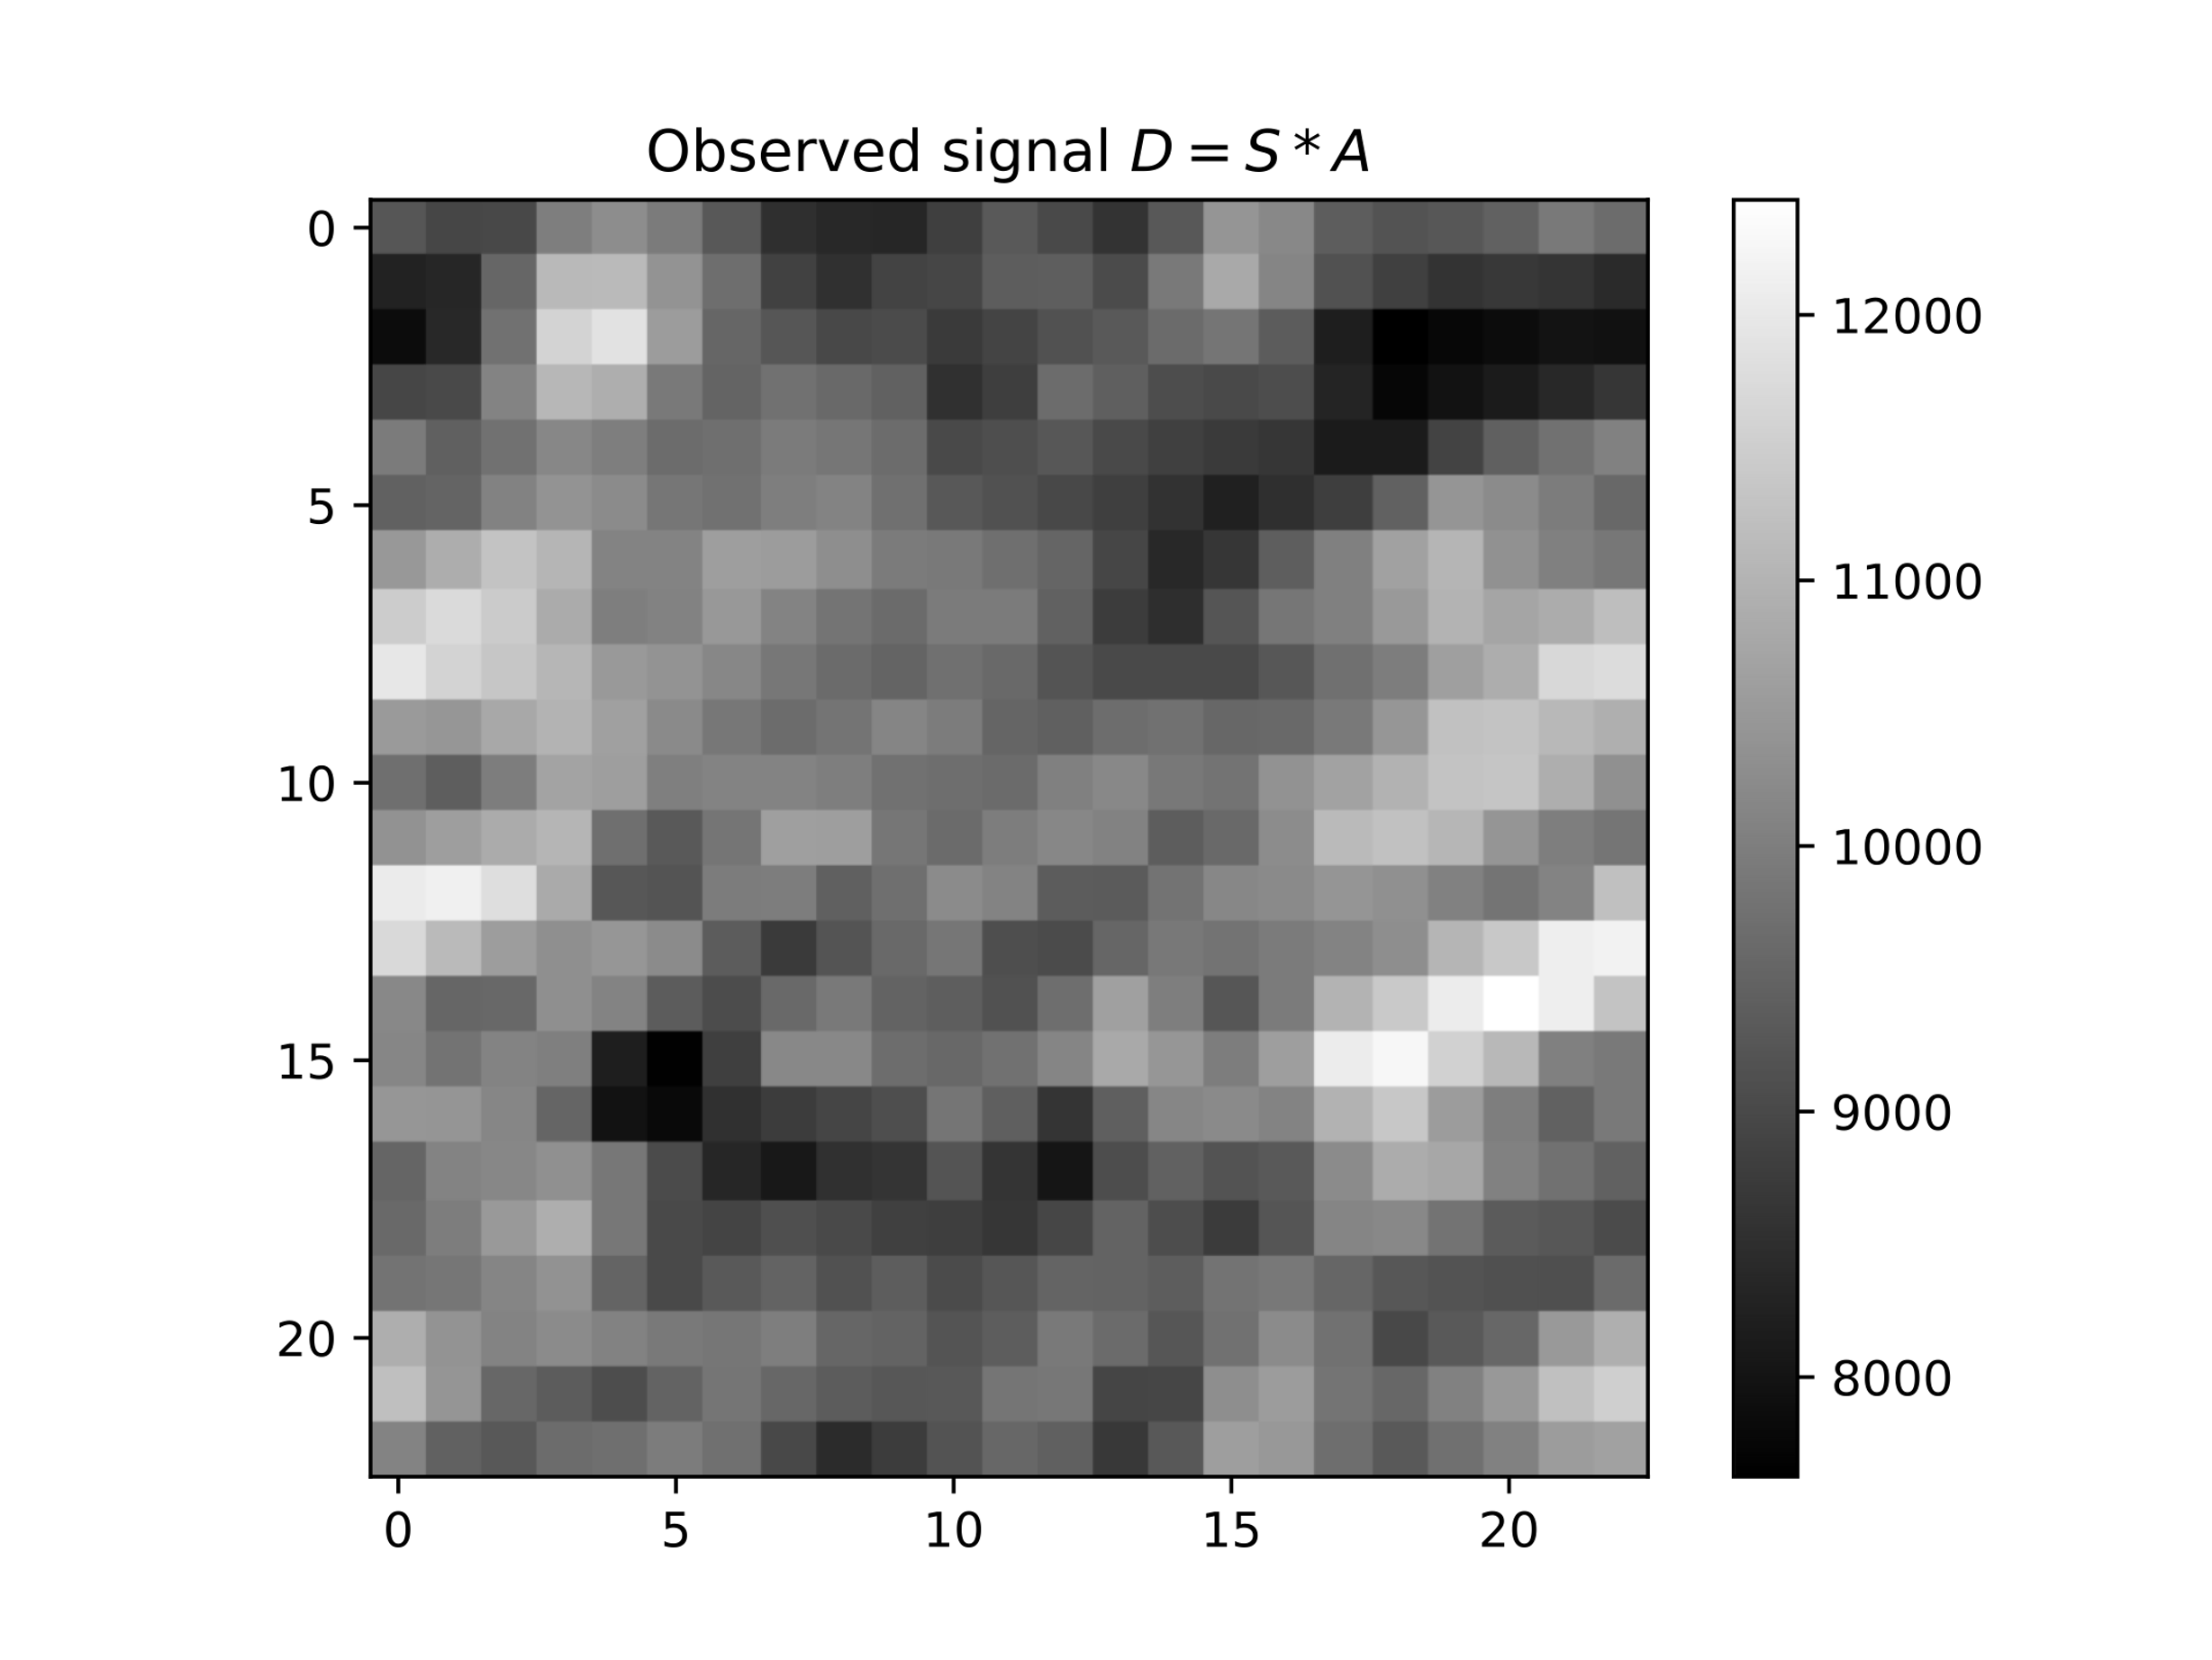
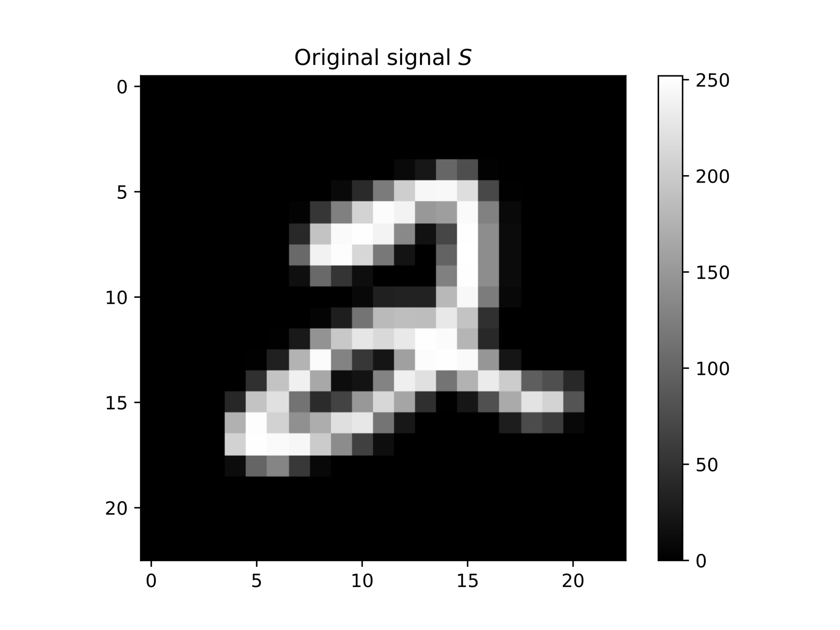
Reconstruction Architecture
The CNN consists of one convolutional layer
kernel = 23
Padding = 11
1 x 23 x 23
1 x 23 x 23
1 x 23 x 23
Convolution

Slide 5
Getting a baseline (target) for the model
Classification accuracy: 98.99% (of 10,000 test images)
The top misclassified digits: 9,4,6,7
9 – misclassified as 4,5,7,8
4 – misclassified as 9,6,2
6 – misclassified as 0,1,3,4,5,8
7 – misclassified as 1,2,4,5,9
1
Classify original MNIST images

Slide 6
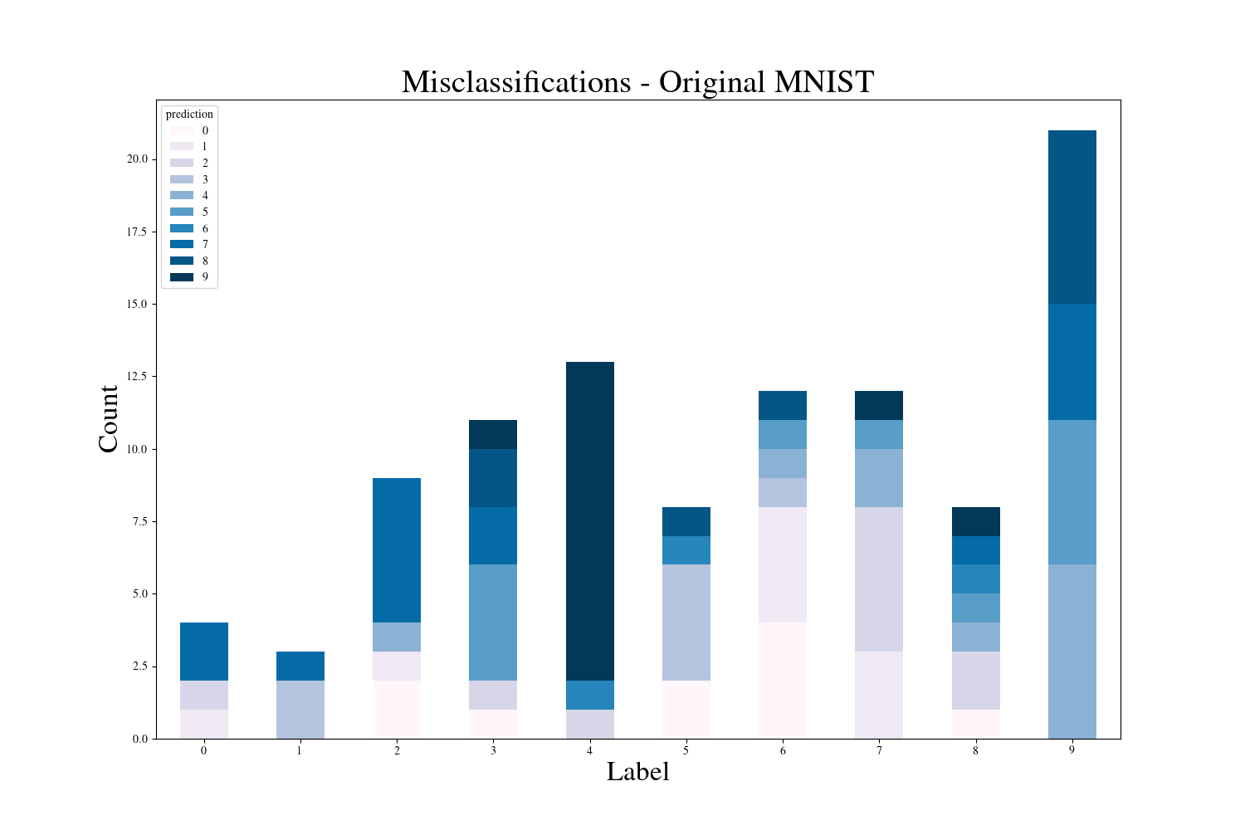

Slide 7
Classifying encoded images doesn’t do too bad
Classification accuracy: 95.35% (10,000 test images)
The top misclassified digits are: 5,7,3,8,9
5 – misclassified as 0, 8, 9, 3, 6, 4, 2
7 – misclassified as 9, 2, 4, 3, 0, 8
3 – misclassified as 8, 7, 5, 9, 2, 1, 0
8 – misclassified as 0, 6, 4, 2, 9, 5, 3, 7
9 – misclassified as 8, 3, 0, 4, 5, 7, 6, 1, 2
2
Classify encoded MNIST images

Slide 8
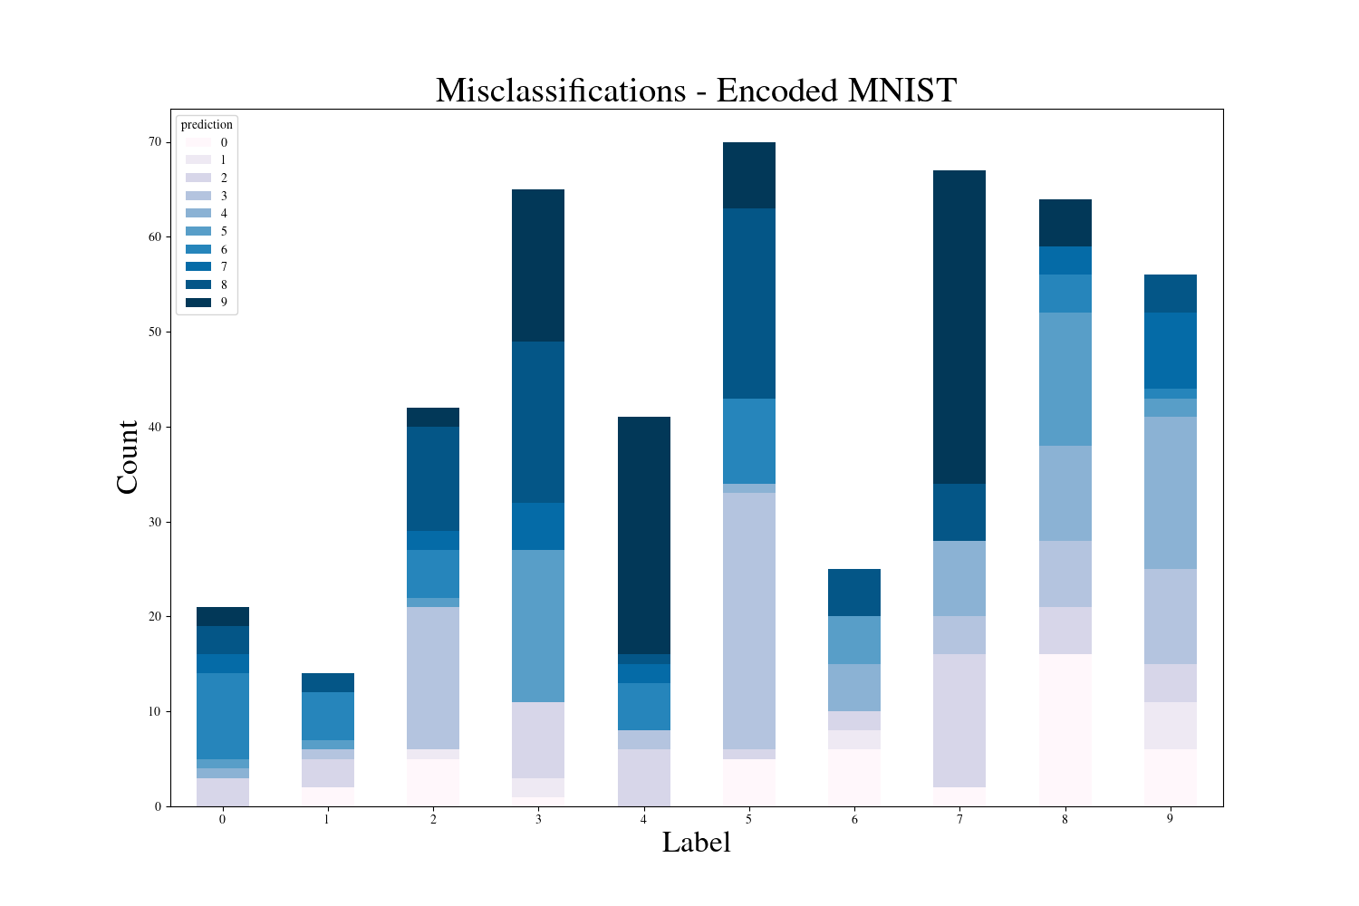

Slide 9
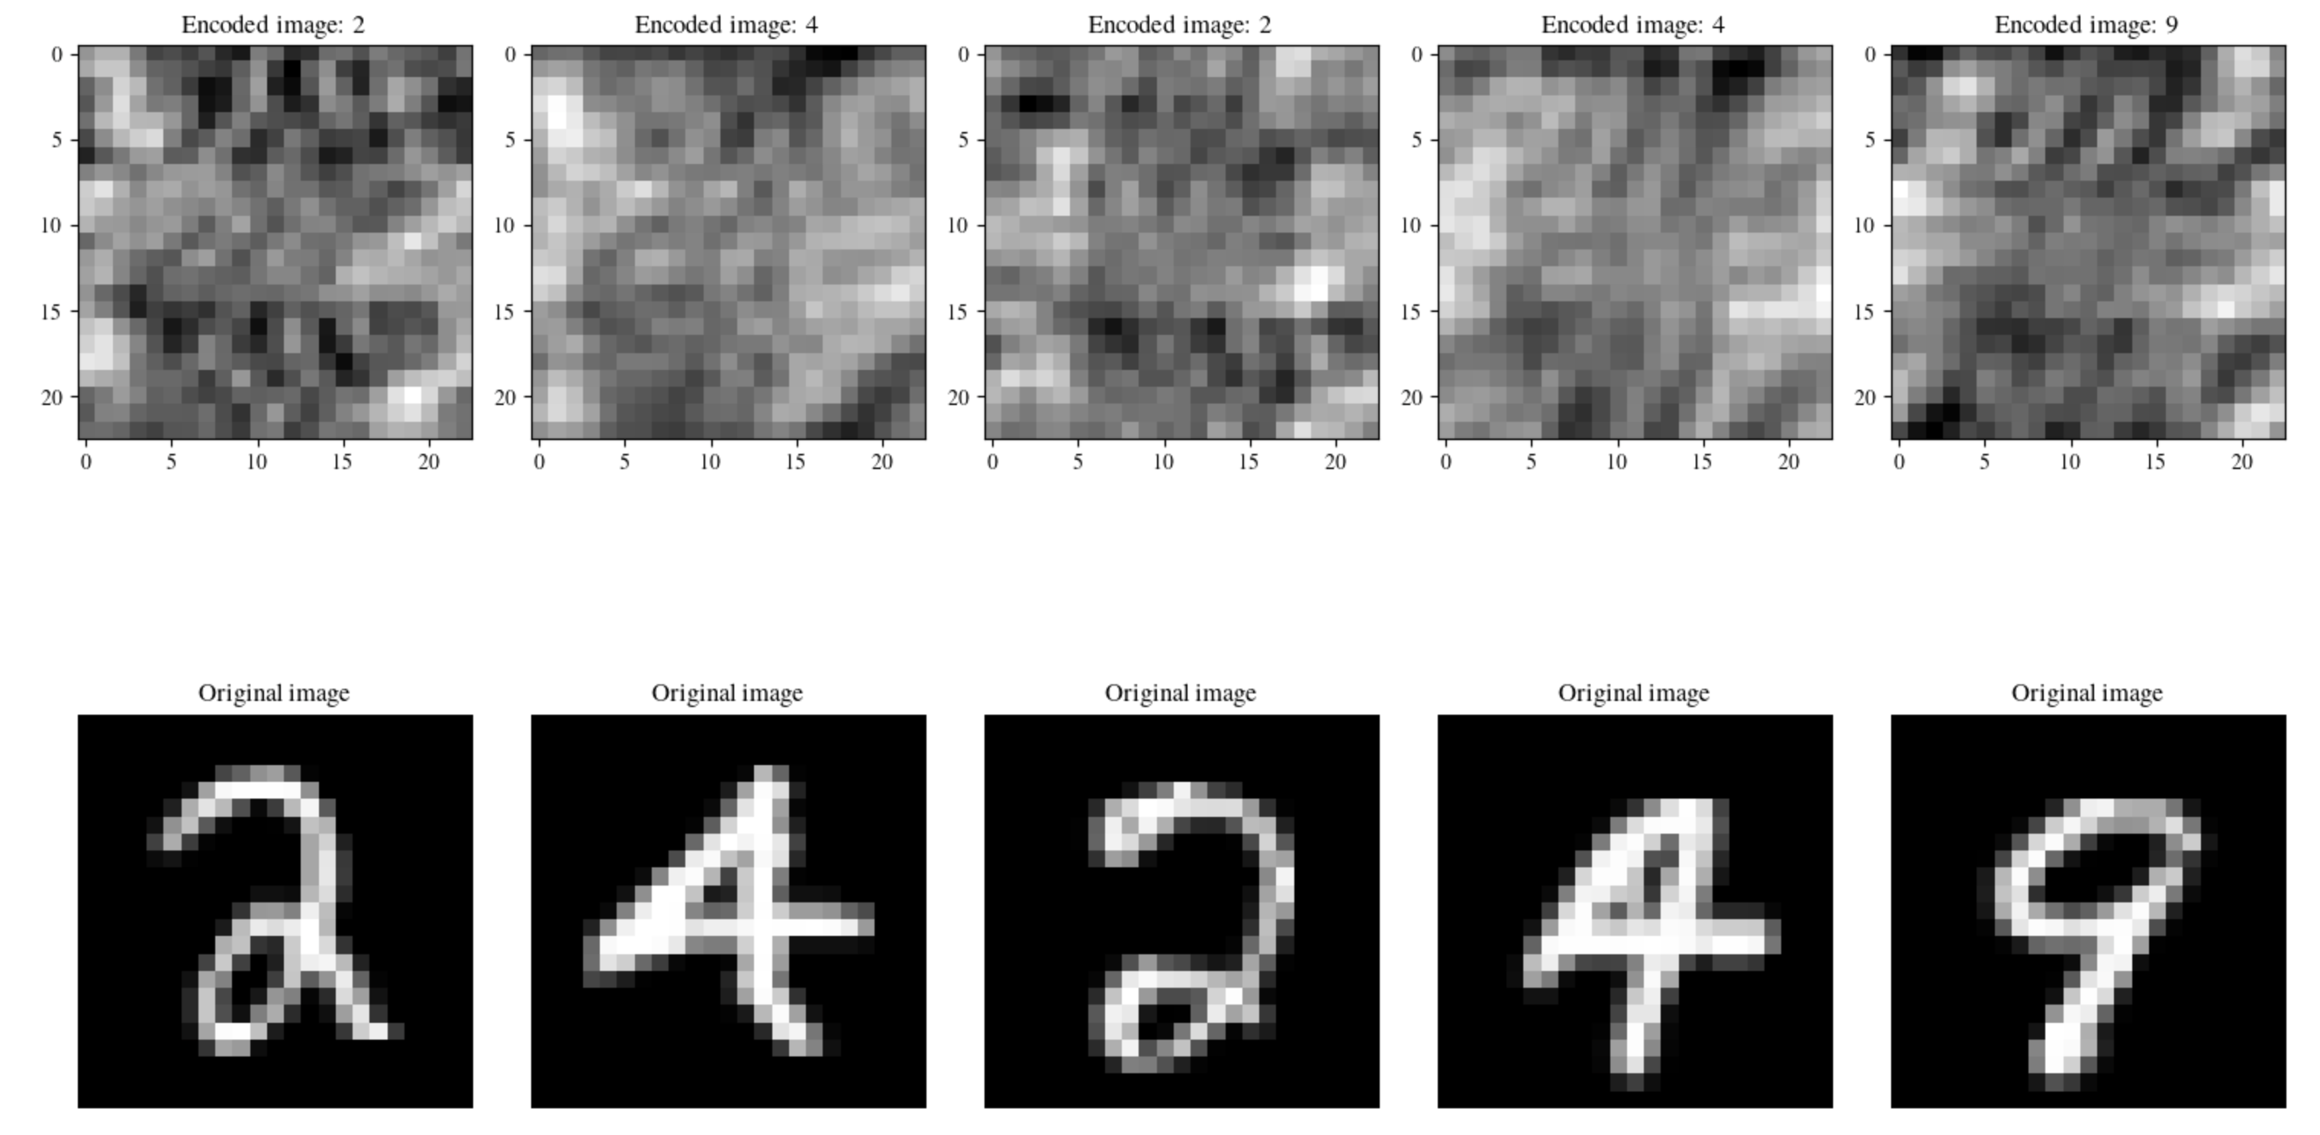
What if we try to reconstruct first?
Input
3
Reconstruct encoded MNIST images, then classify from reconstructions
CNN with Sigmoid activation
CNN with NO activation
Target

Slide 10
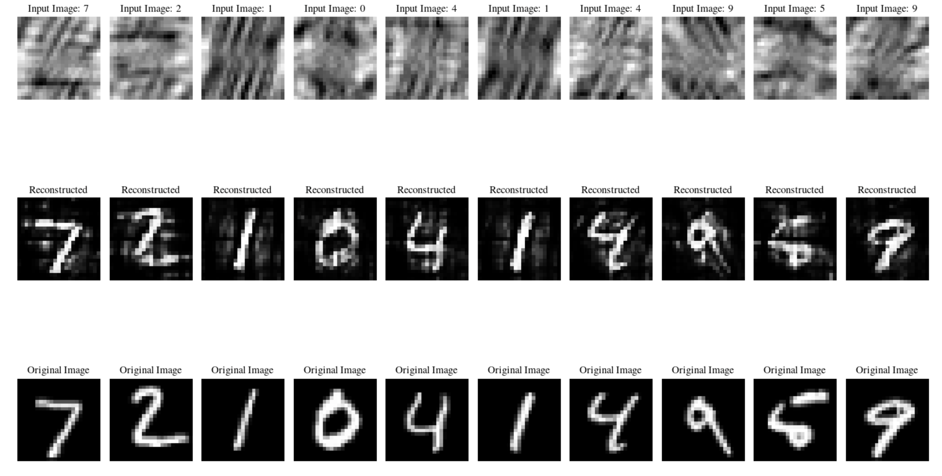
Reconstructions using Sigmoid Activation

Slide 11
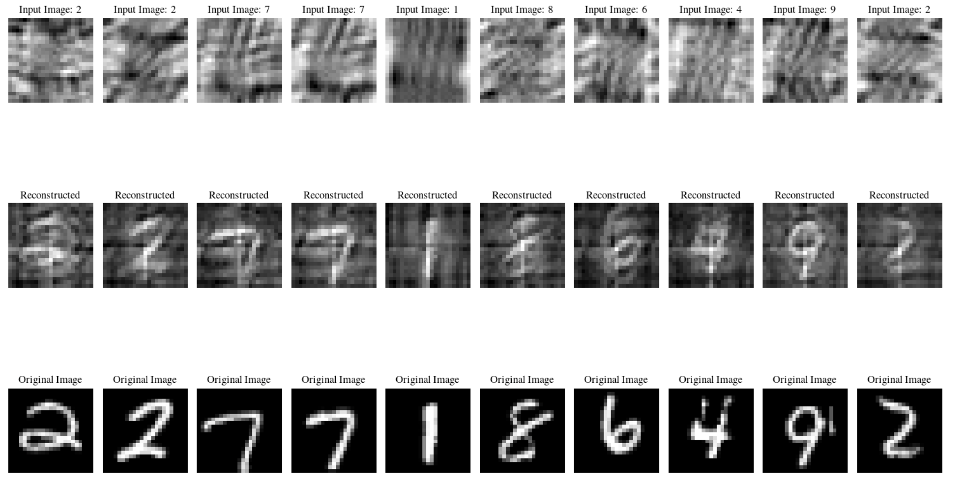
Reconstructions using NO Activation

Slide 12
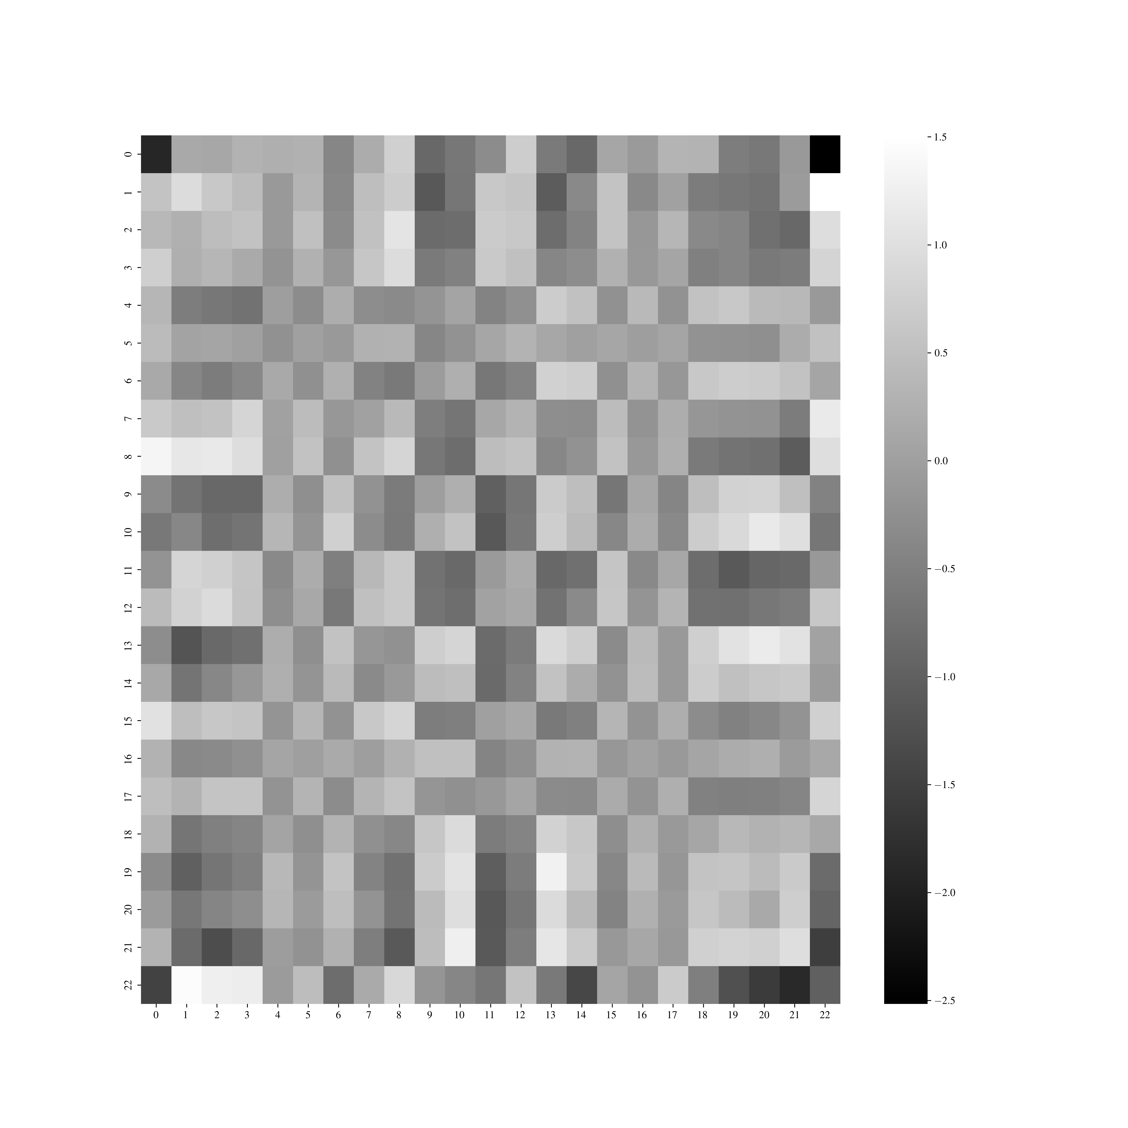
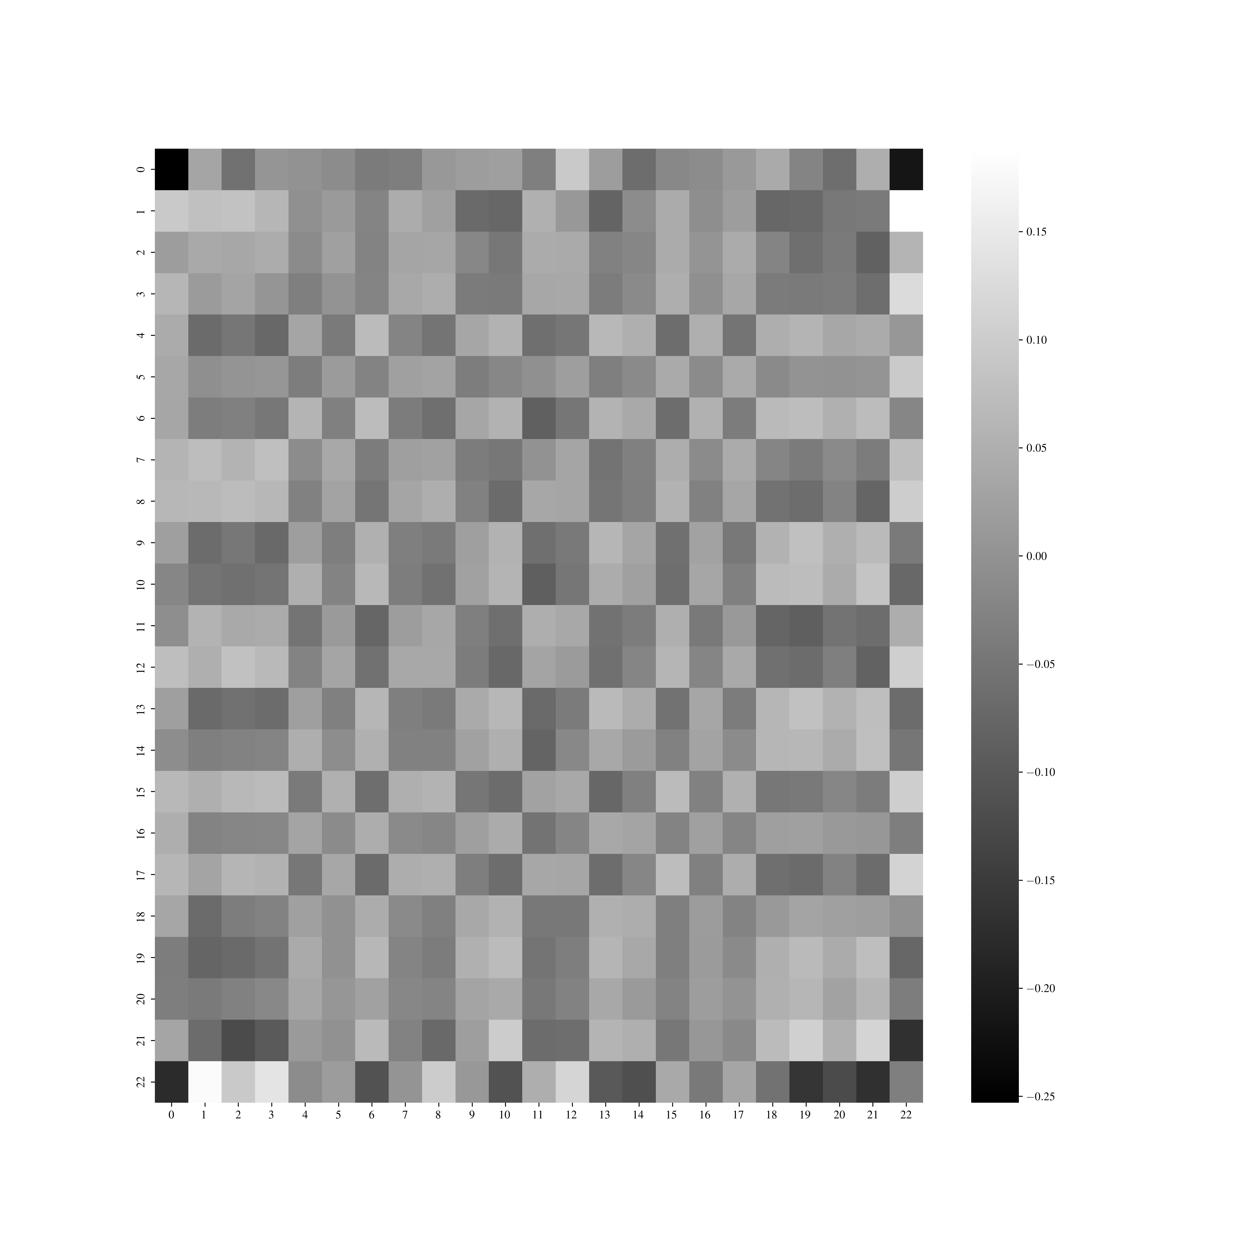
How do the weights differ?
Sigmoid activation
NO activation

Slide 13
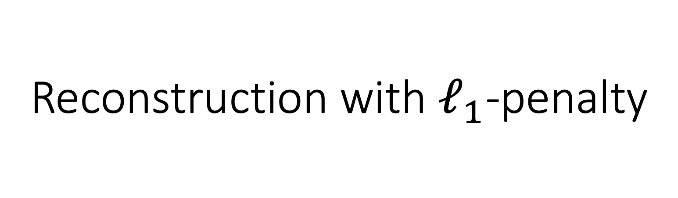
Reconstruction with $ℓ_{1}$-penalty

Slide 14
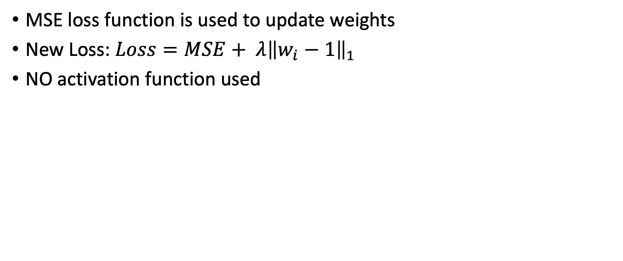
Constraining the weights with a penalty
MSE loss function is used to update weights
New Loss: $Loss=MSE+ λ{\left\|w_{i}−1\right\|}_{1}$
NO activation function used
Notes:
Started with lambda=1 and then went smaller

Slide 15
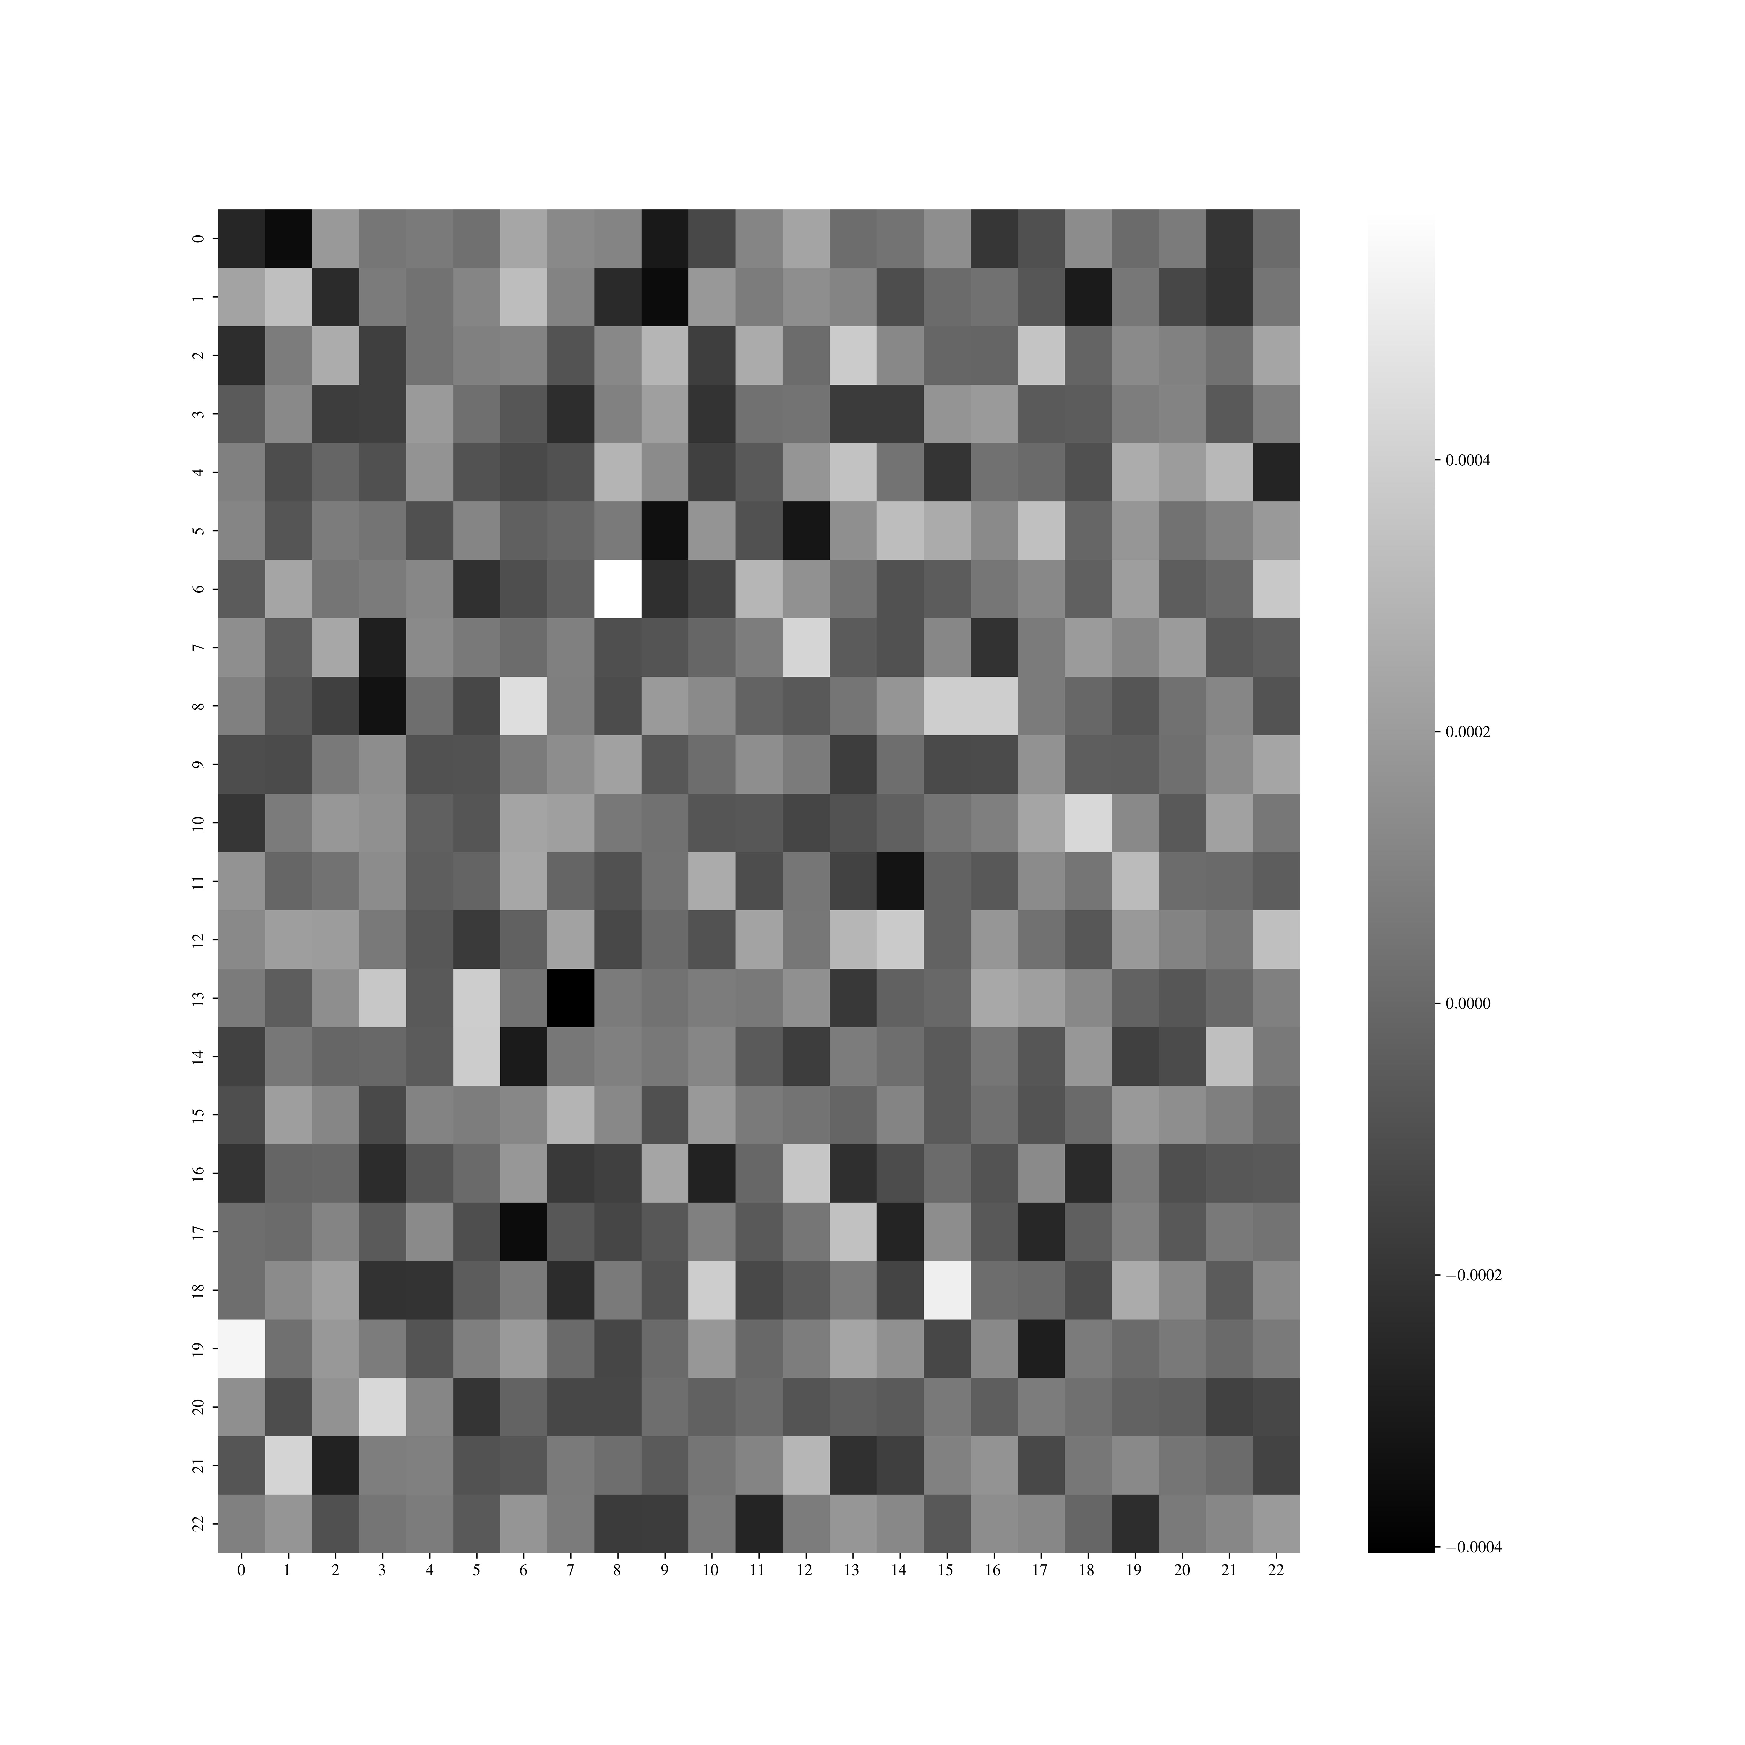
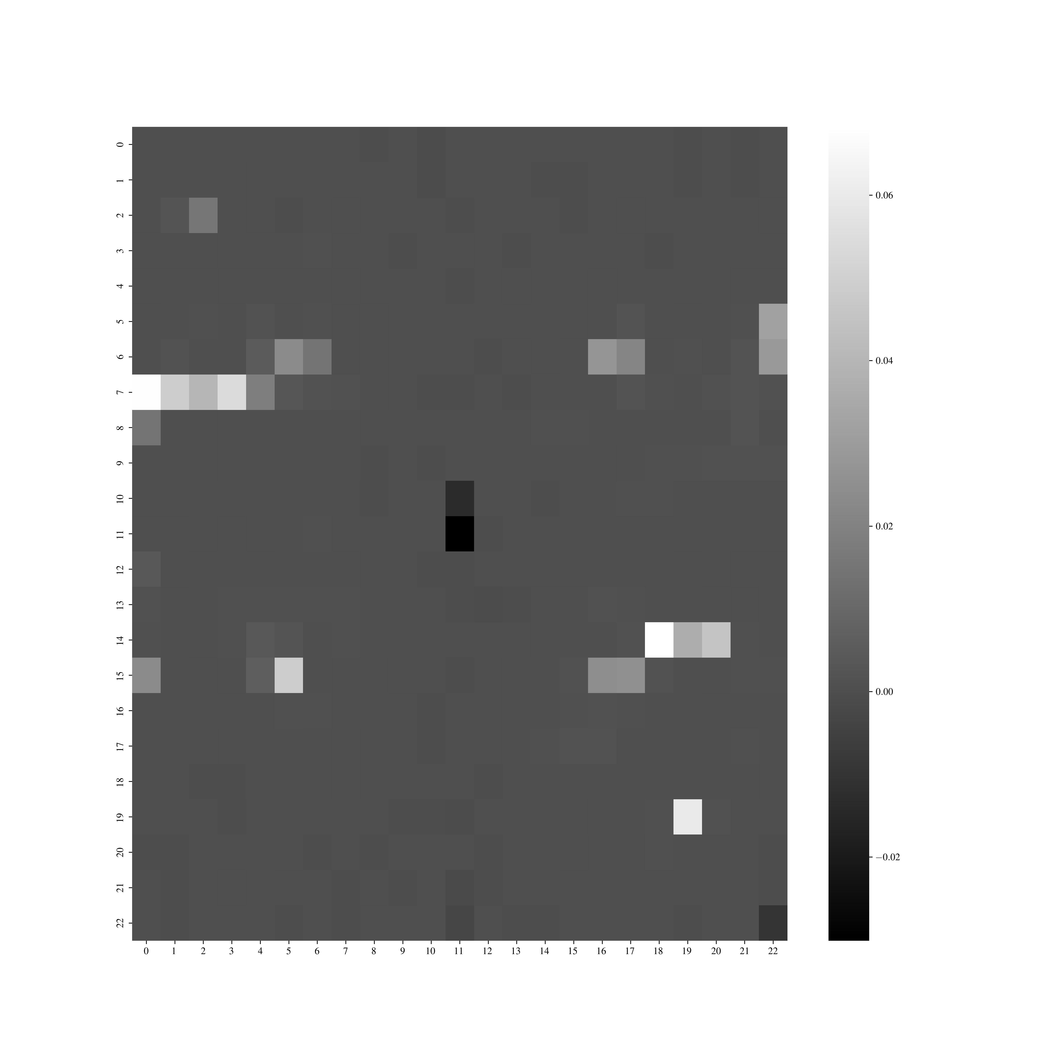
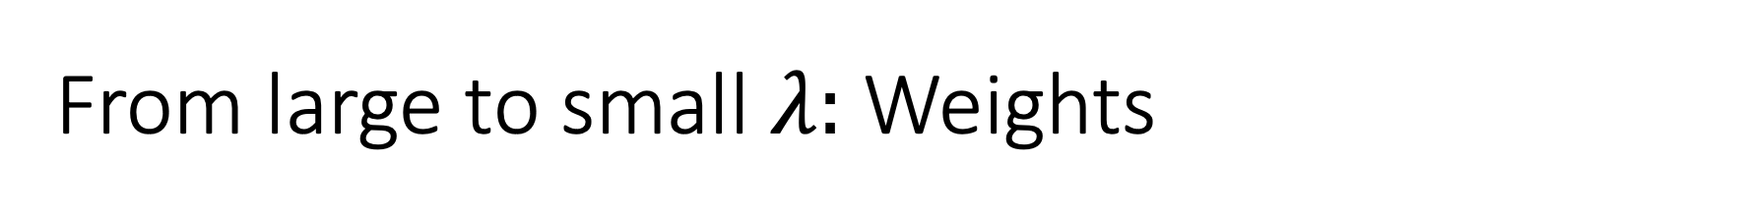
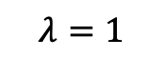
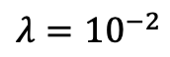
From large to small $λ:$ Weights
$$λ=1$$
$$λ={10}^{−2}$$

Slide 16
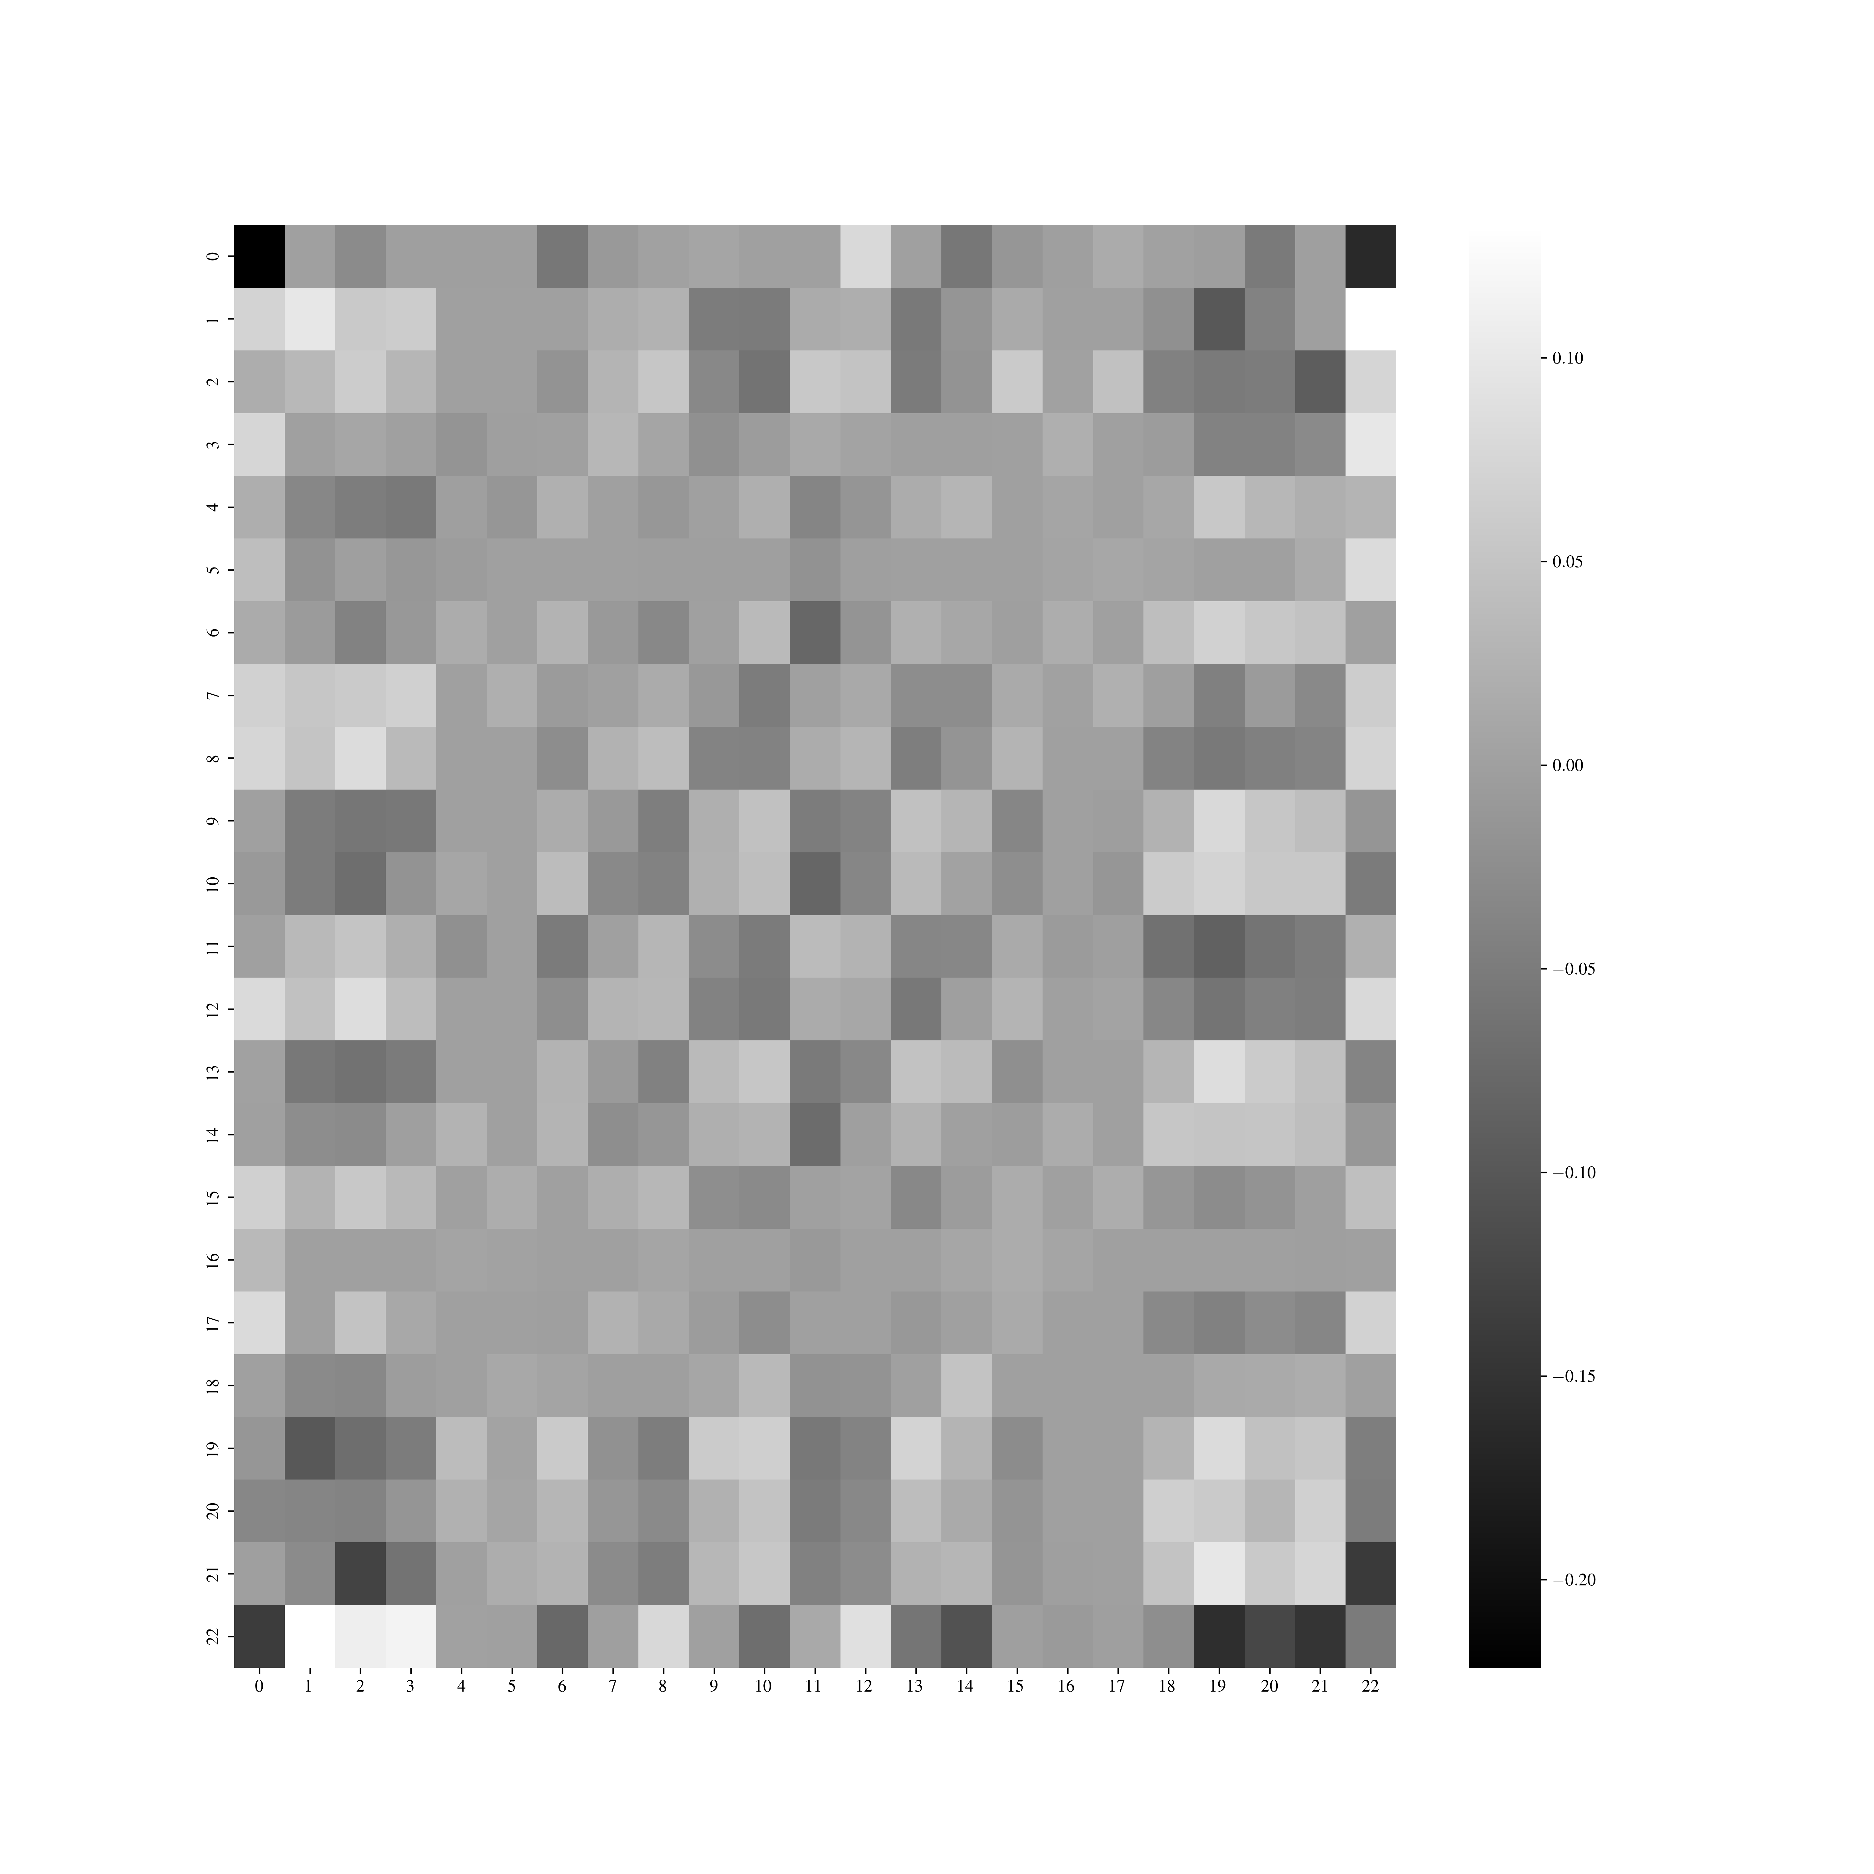

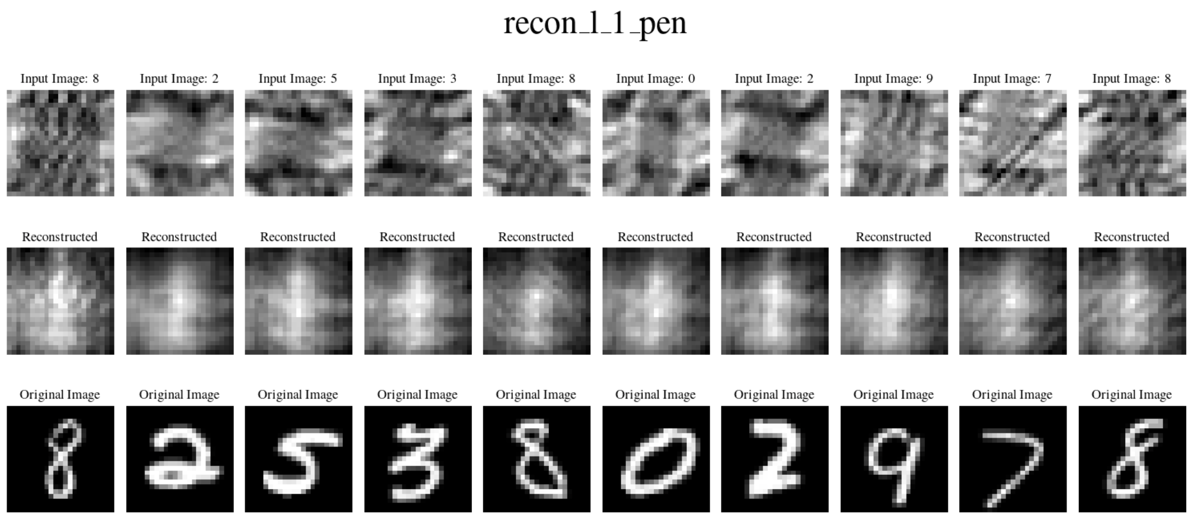
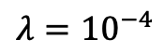
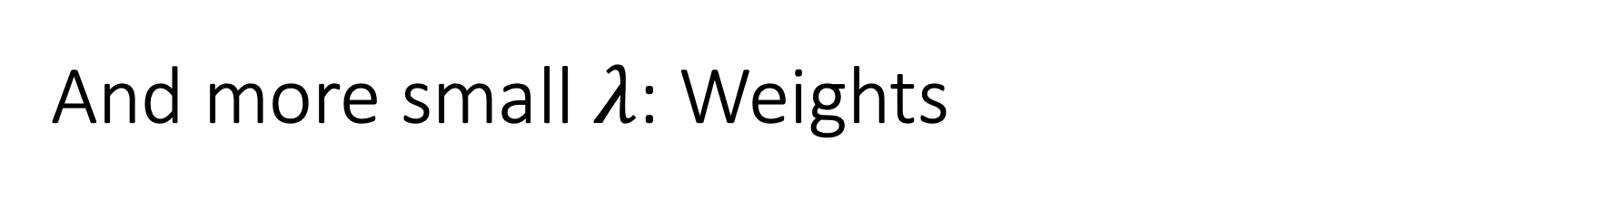
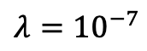
And more small $λ$: Weights
$$λ={10}^{−4}$$
$$λ={10}^{−7}$$

Slide 17
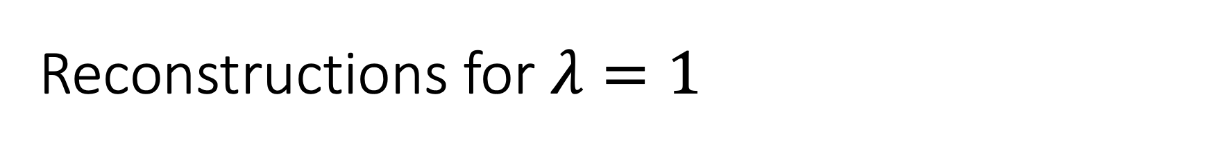
Reconstructions for $λ=1$

Slide 18
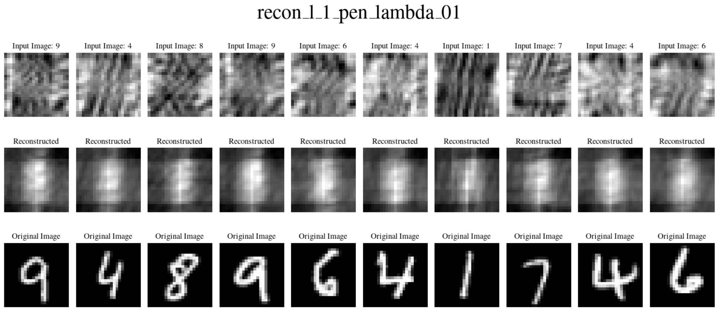
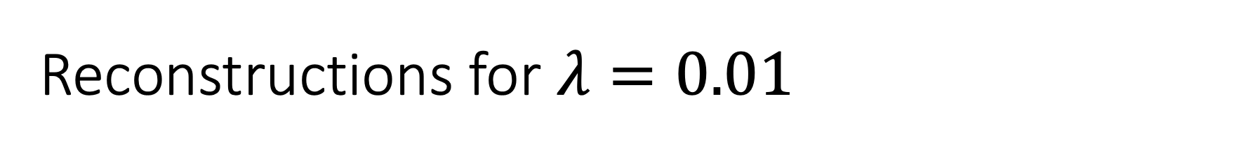
Reconstructions for $λ=0.01$

Slide 19
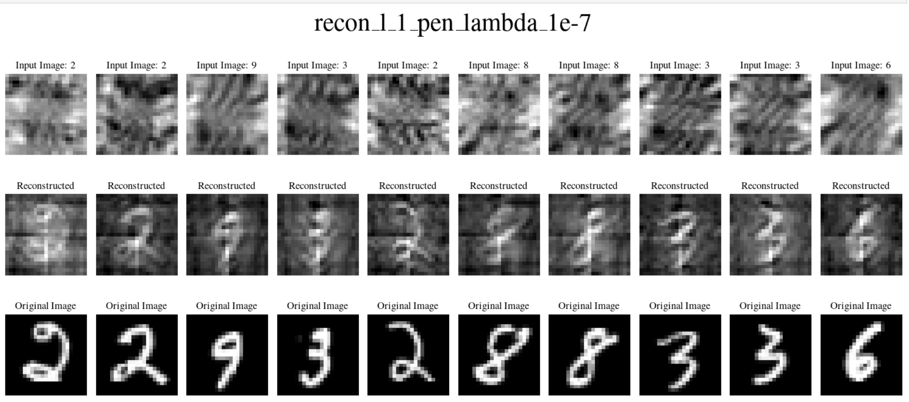
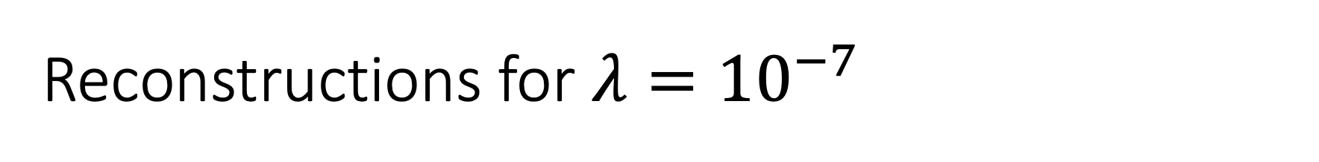
Reconstructions for $λ={10}^{−7}$

Slide 20
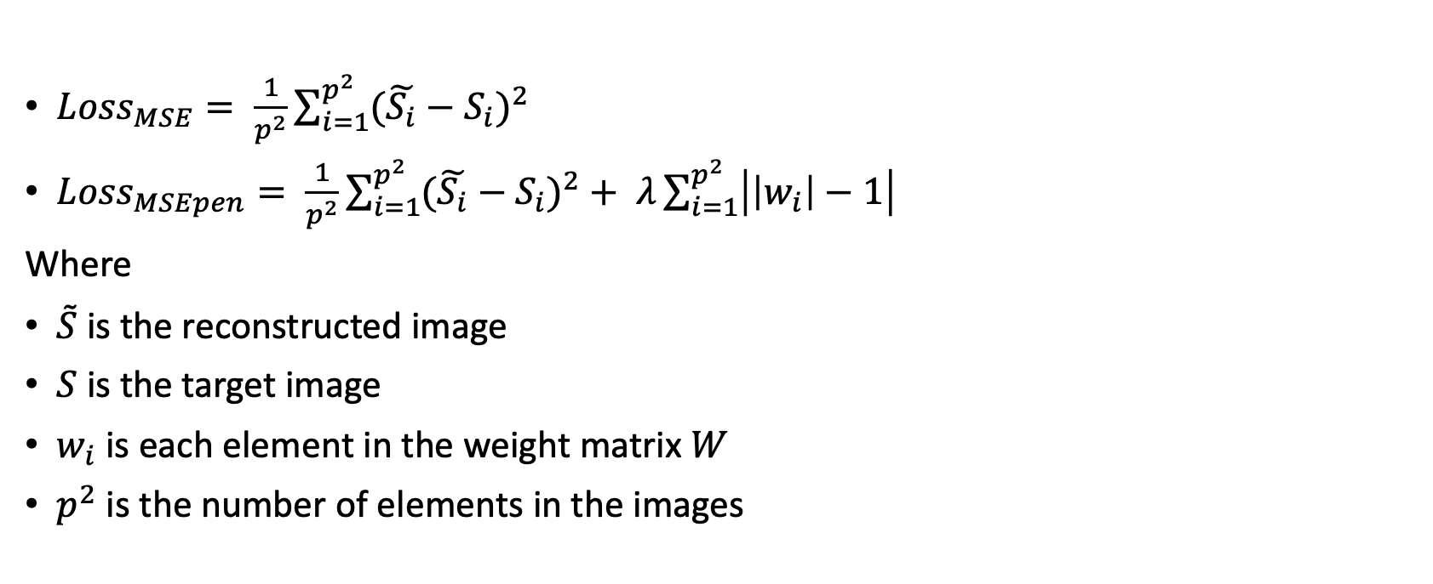
After fixing the loss:
${Loss}_{MSE}= \frac{1}{p^{2}}\sum_{i=1}^{p^{2}}{{(\tilde{S_{i}}−S_{i})}^{2}}$
${Loss}_{MSEpen}= \frac{1}{p^{2}}\sum_{i=1}^{p^{2}}{{(\tilde{S_{i}}−S_{i})}^{2}}+ λ\sum_{i=1}^{p^{2}}{\left|\left|w_{i}\right|−1\right|}$
Where
$\tilde{S}$ is the reconstructed image
$S$ is the target image
$w_{i}$ is each element in the weight matrix $W$
$p^{2}$ is the number of elements in the images

Slide 21
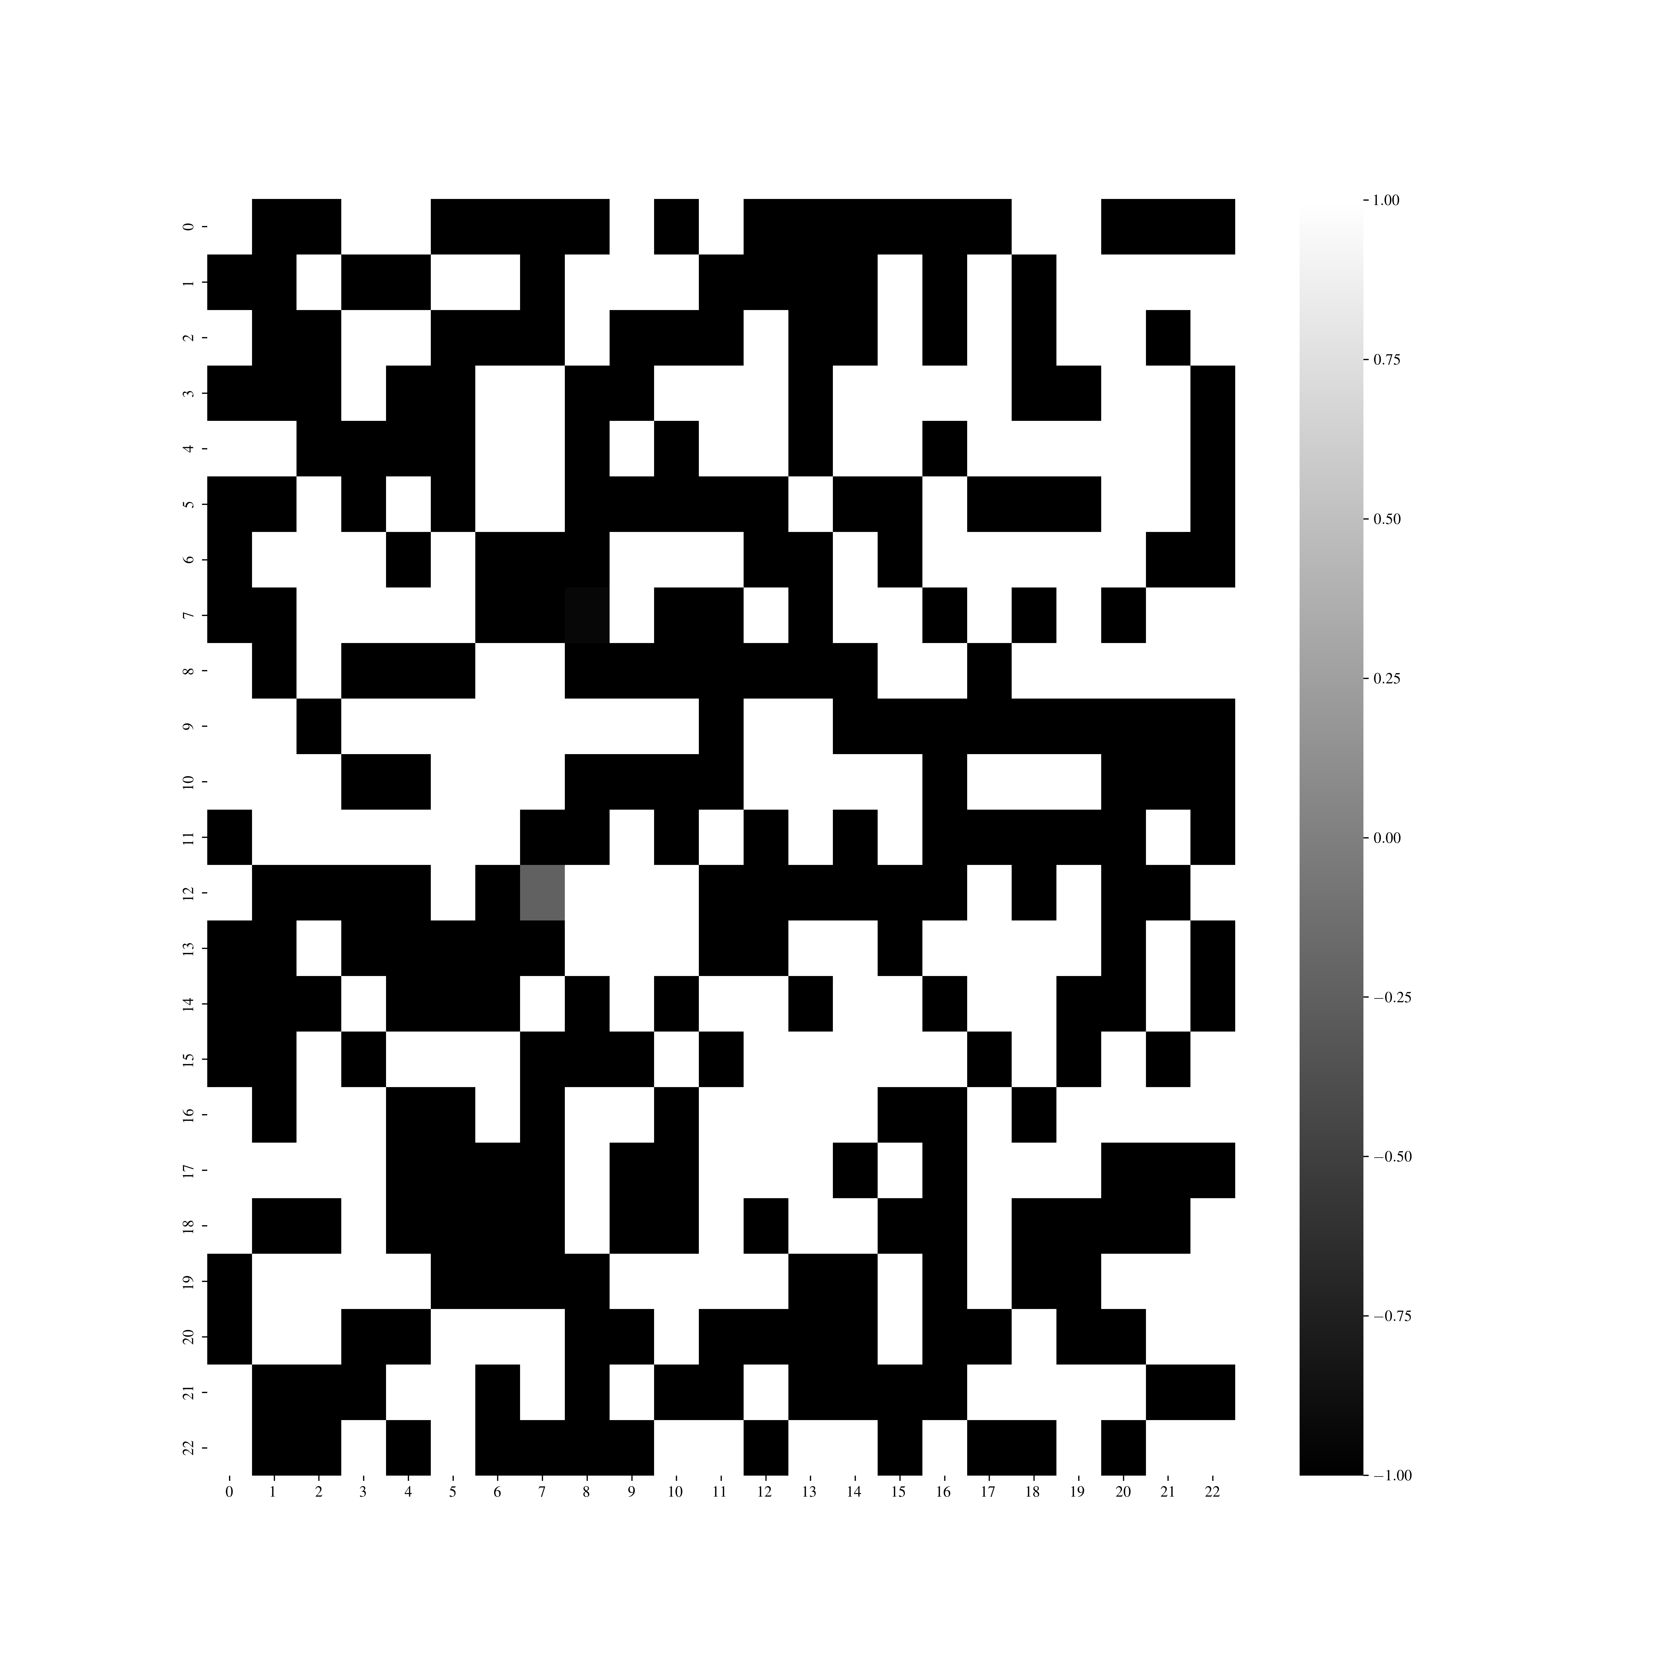
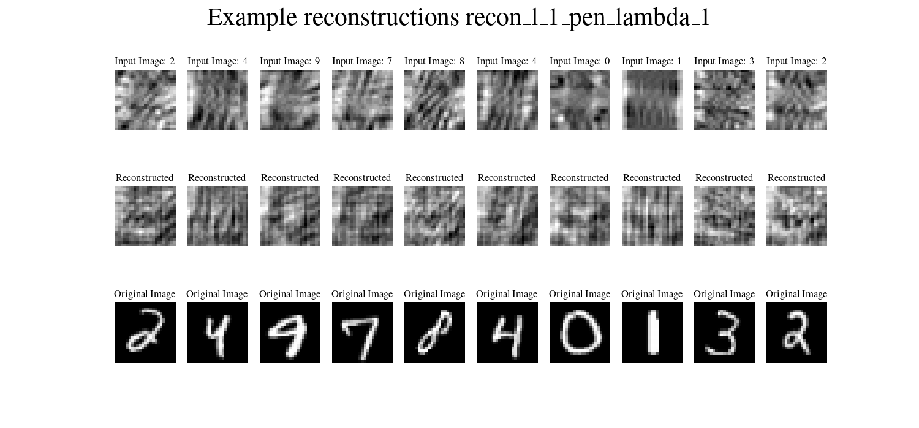
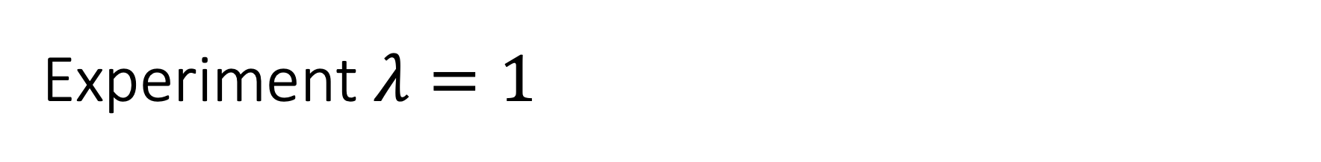
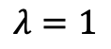
Experiment $λ=1$
$$λ=1$$

Slide 22
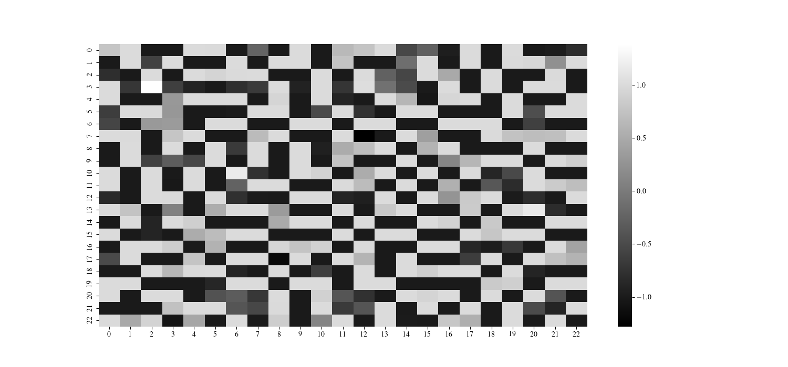
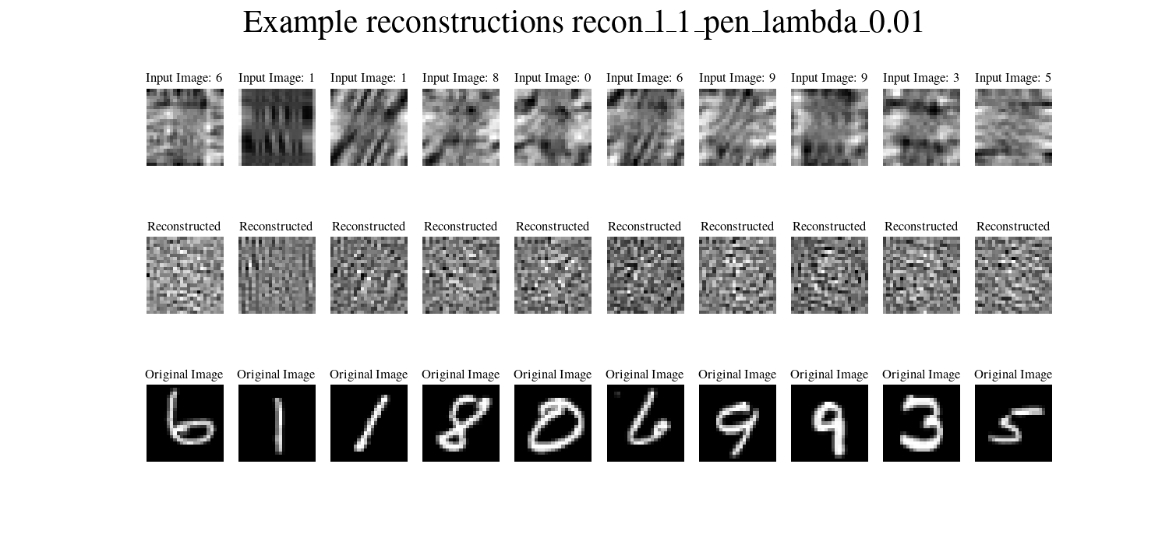
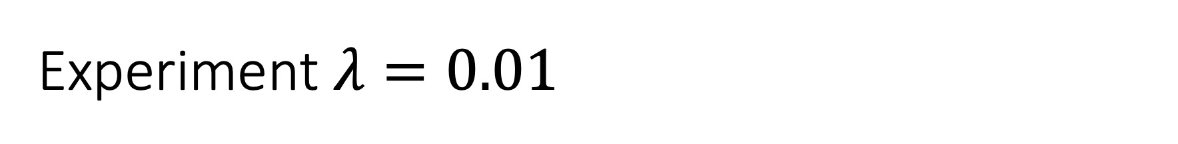
Experiment $λ=0.01$

Slide 23
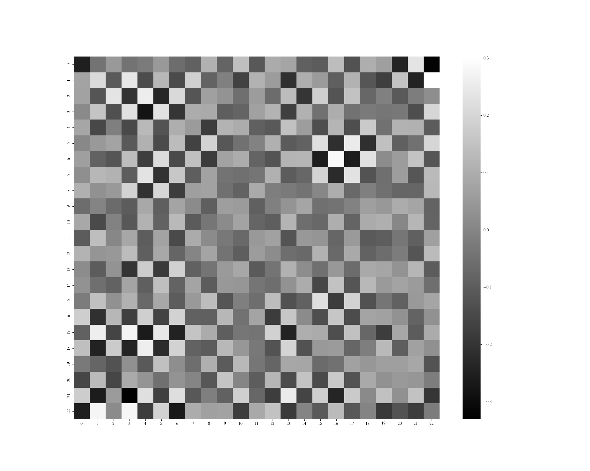
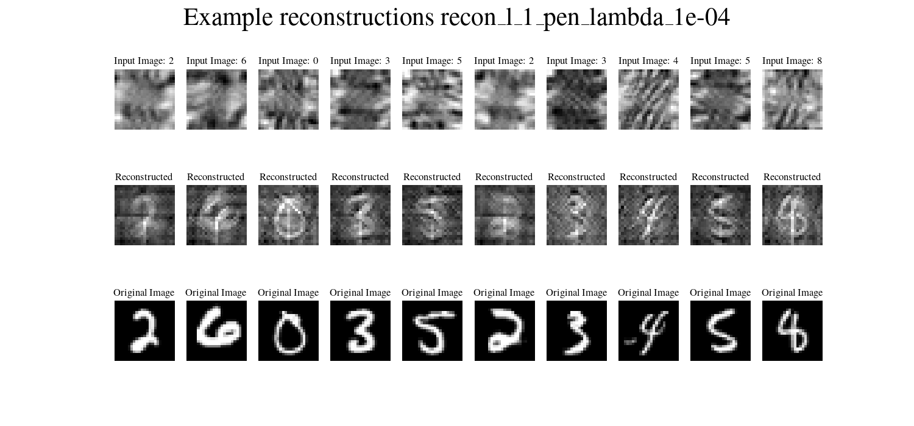
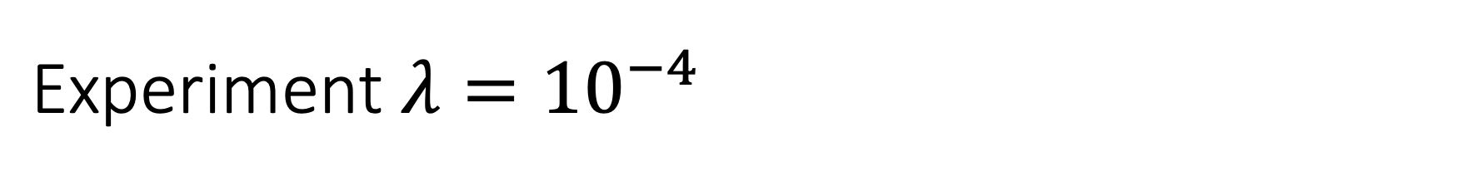
$$\text{Experiment} λ={10}^{−4}$$

Slide 24
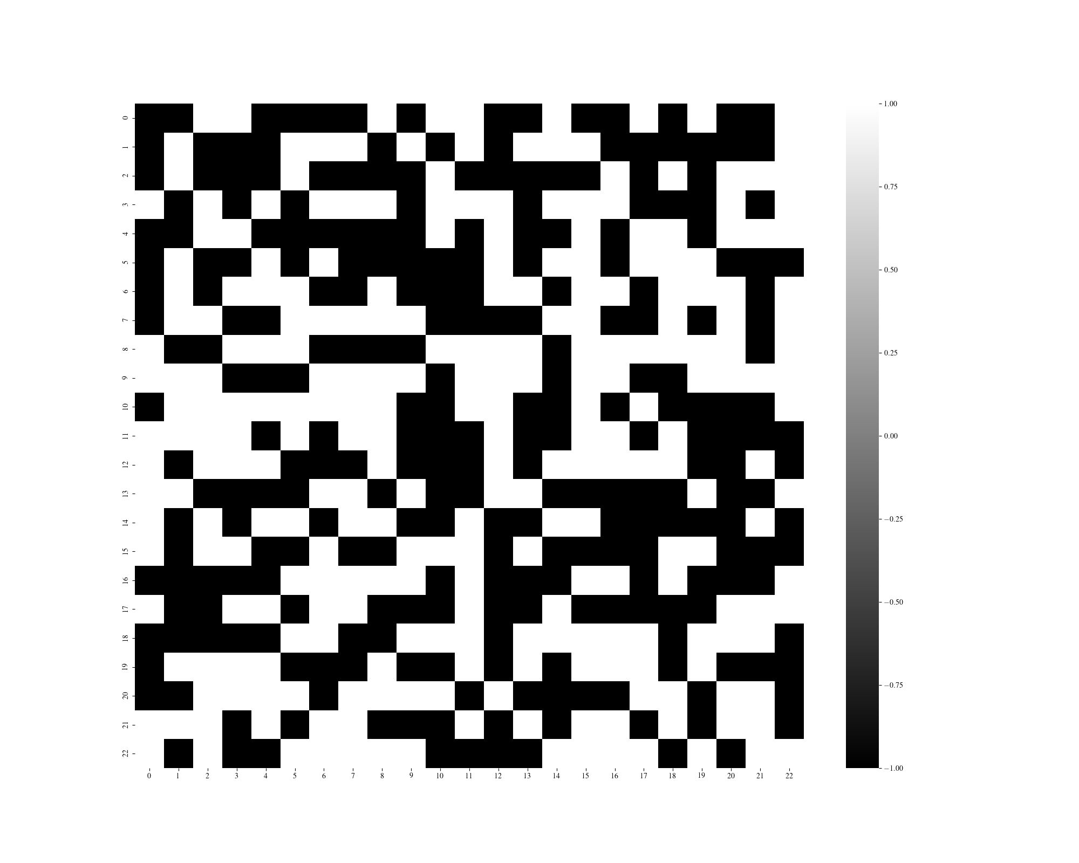
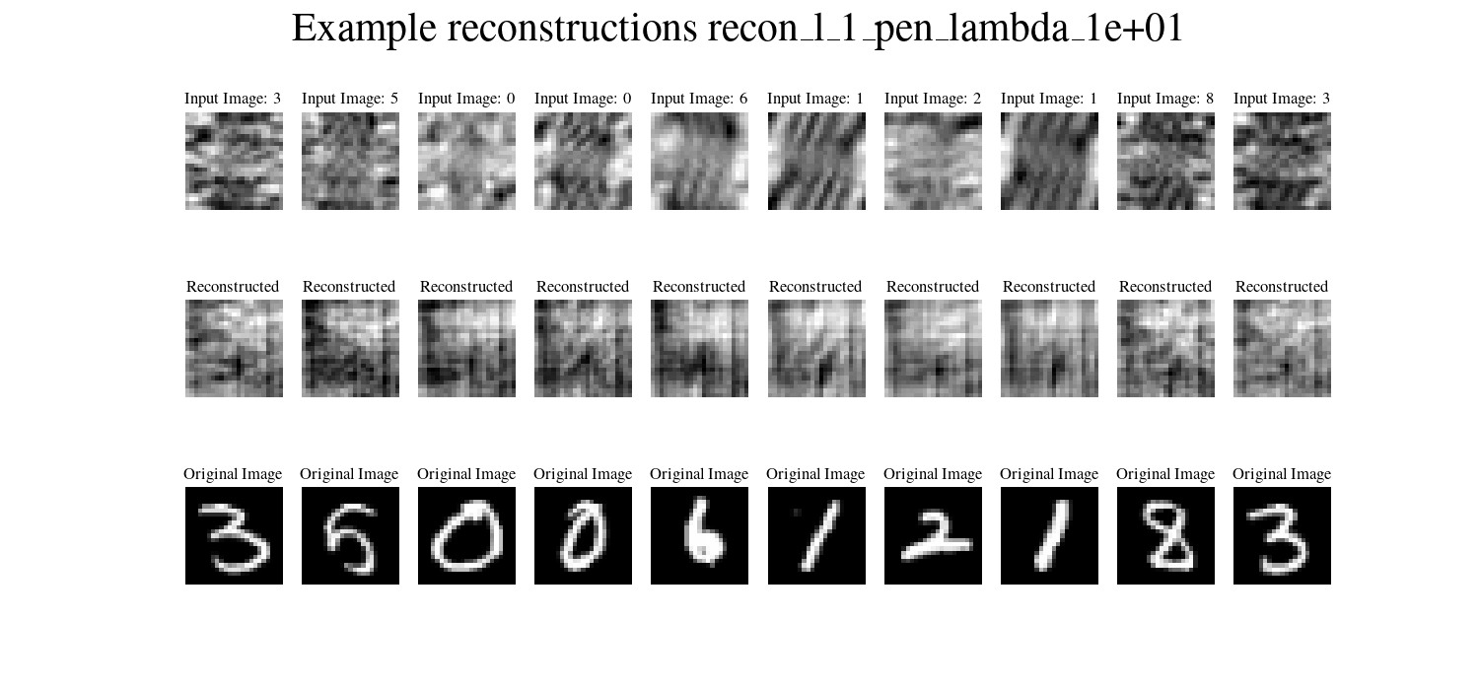
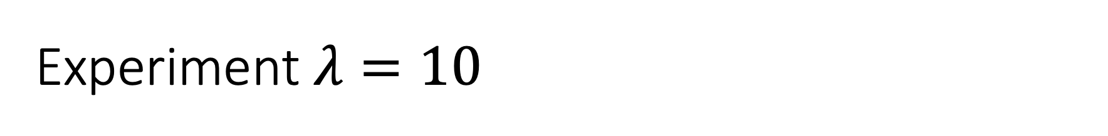
Experiment $λ=10$

Slide 25
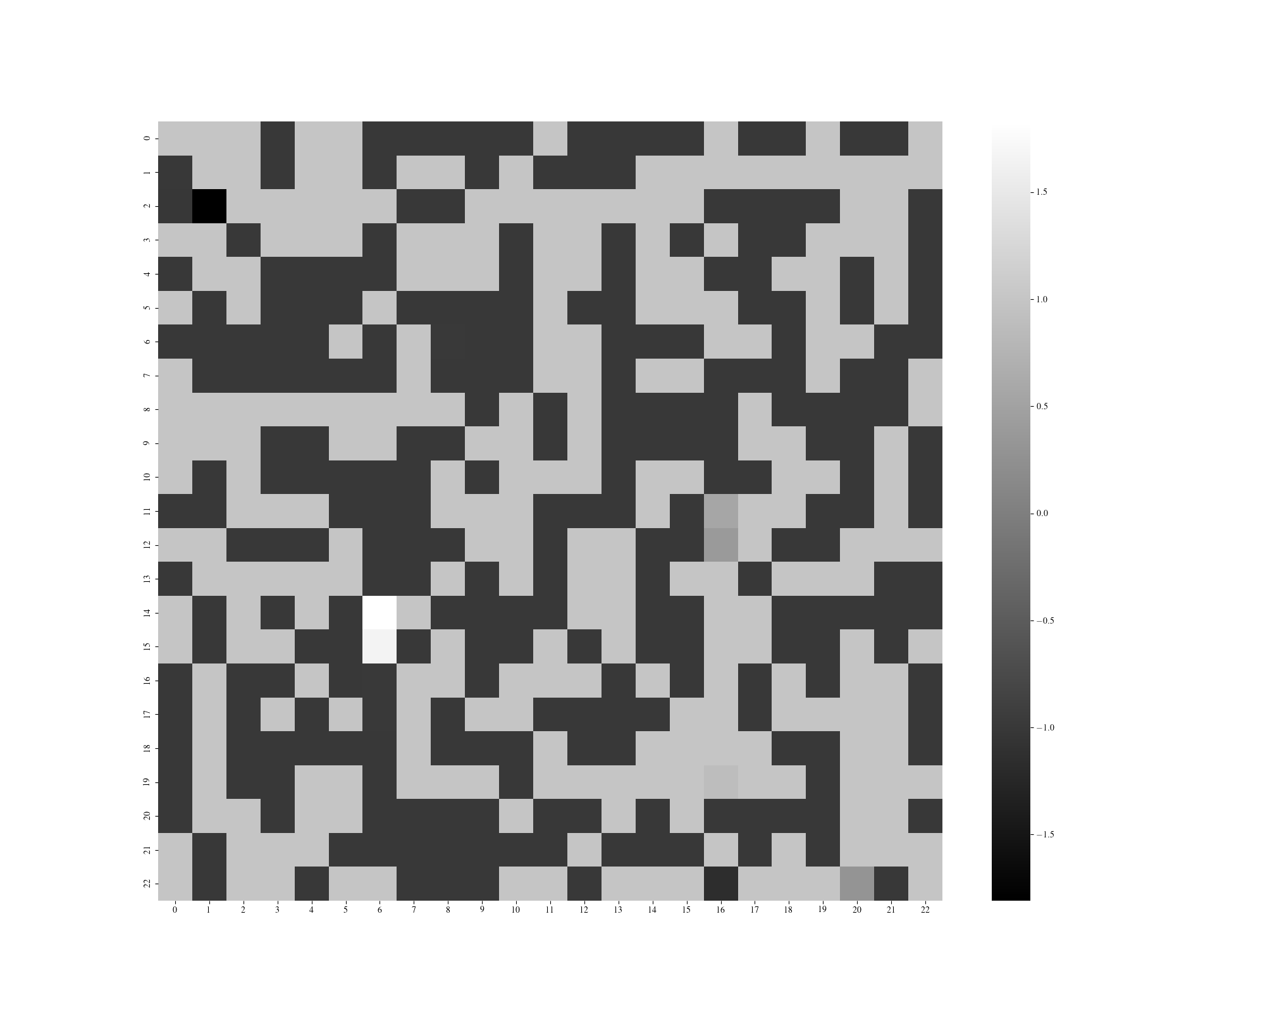
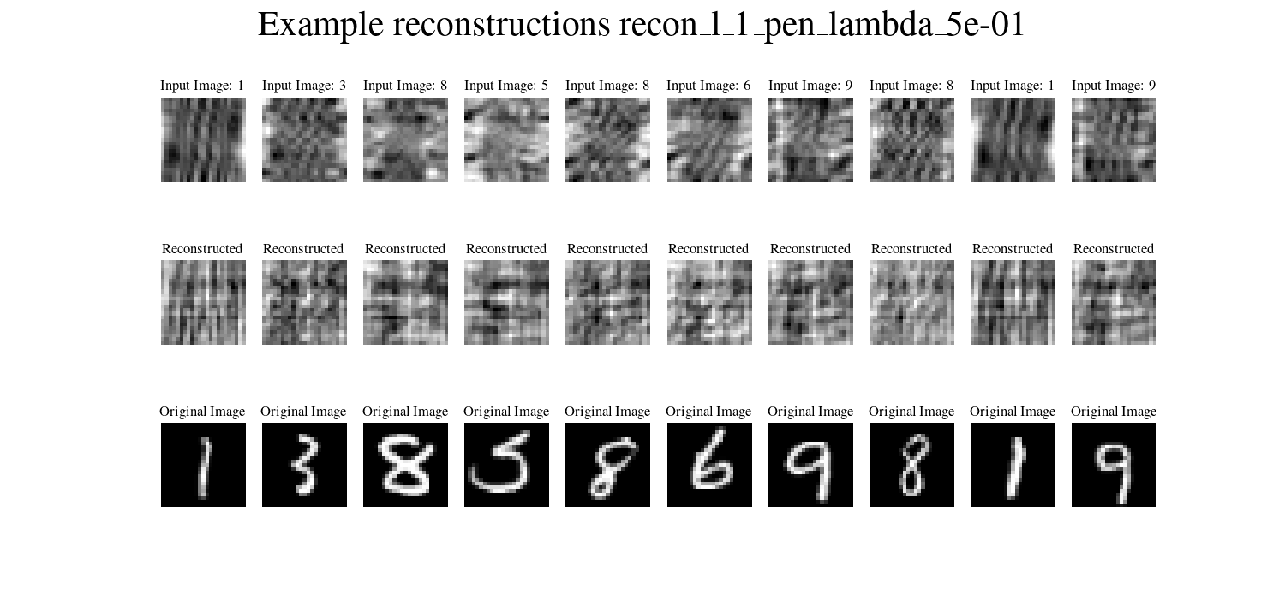
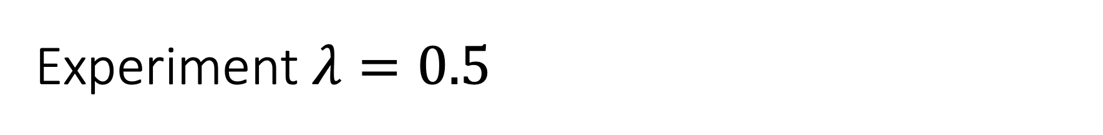
Experiment $λ=0.5$

Slide 26
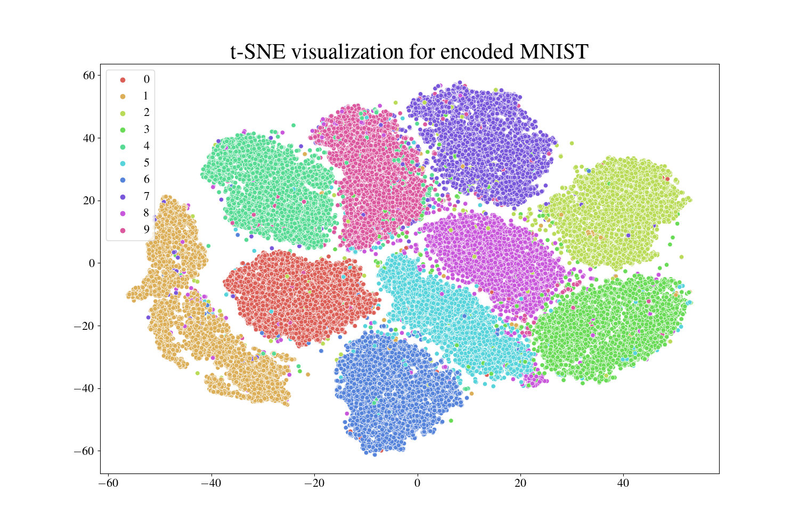
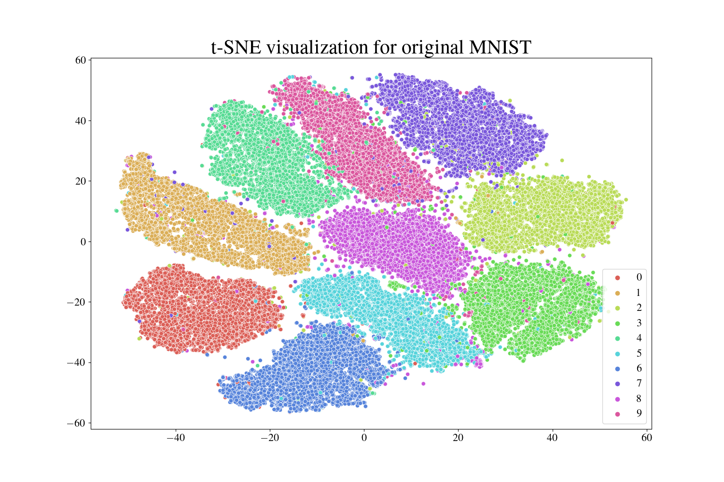
7
7
9
4
9
4
2
1
2
8
8
0
1
5
3
0
3
5
6
6

Slide 27
Figures

Slide 28



Brain Disorders
Cancer
Heart Conditions
Brain Disorders
Cancer
Heart Conditions
Alzheimer’s Disease
Parkinson’s Disease
Epilepsy
Kidney cancer
Ovarian cancer
Thyroid cancer
Coronary Artery Disease
Heart Failure

Slide 31

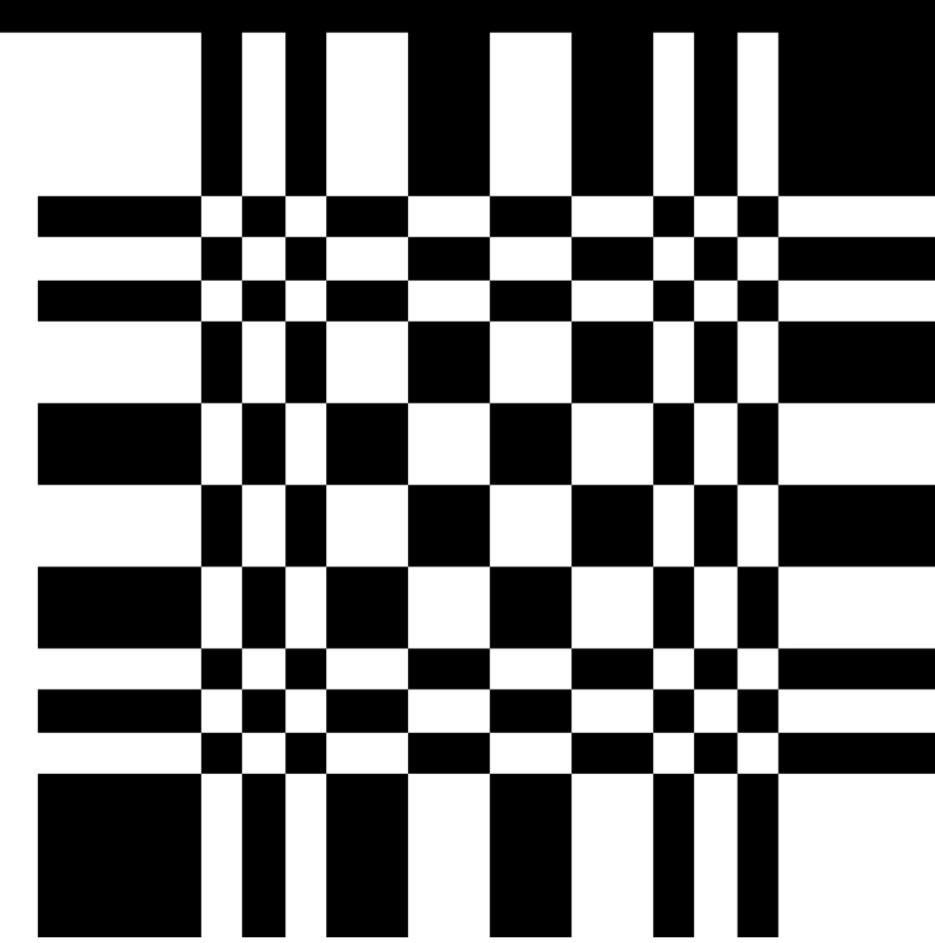
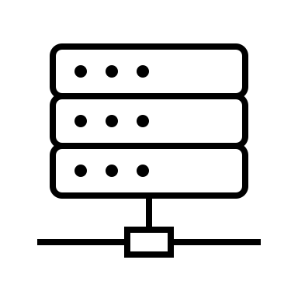

Xray pinhole camera (wip)
X-RAY SOURCE
DECODING PROCEDURE
RECONSTRUCTED IMAGE
X-RAYS
PATIENT
APERTURE
DETECTOR

Slide 32

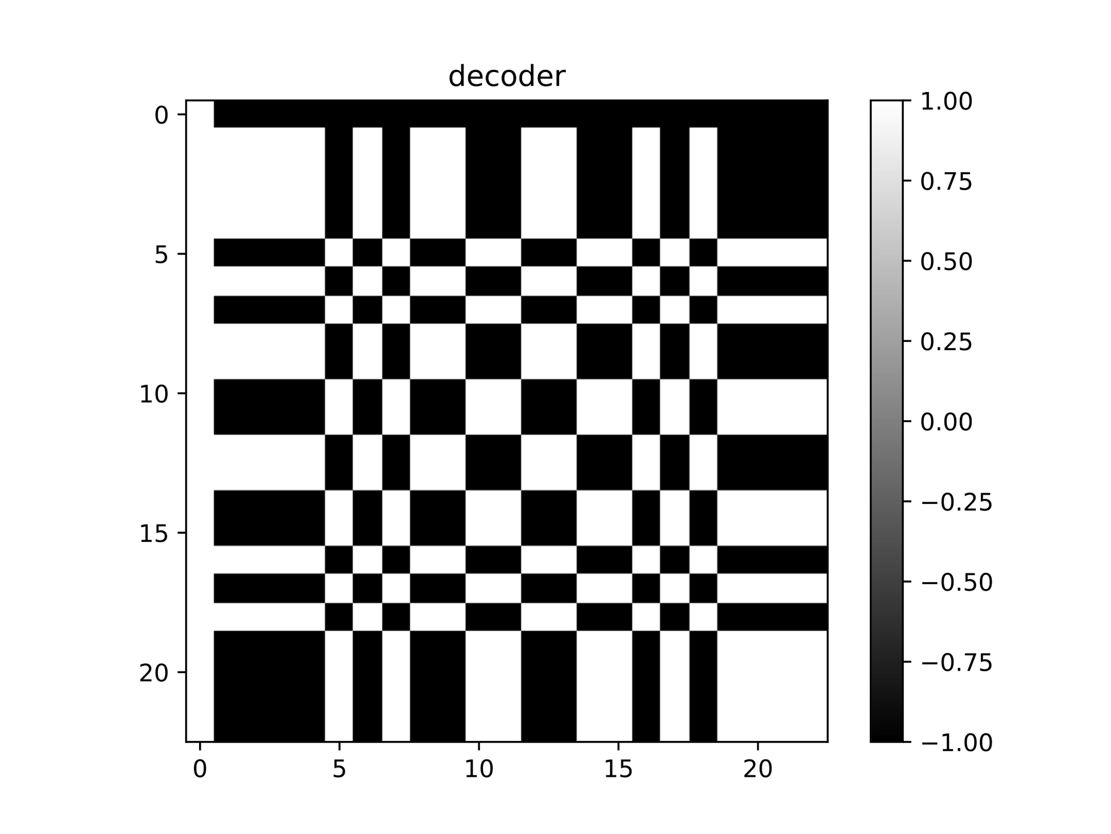






$$∗$$
$$=$$
Coded aperture $A$
Decoding pattern $G$
$$δ$$

Slide 33



Aperture
Observation
Signal

Slide 34


Aperture
Observation
Signal

Slide 35


Aperture
Observation
Signal

Slide 36



$$∗$$
$$∗$$
$$=$$

Slide 37
$$∗$$
$$∗$$
$$=$$
Coded observation

Slide 38




Signal
Aperture
Observation
Reconstruction
$$S$$
$$A$$
$$D$$
$$\hat{S}$$

Slide 39
2
X-RAY SOURCE
X-RAYS
SOURCE
APERTURE
OBSERVATION
DECODING PROCEDURE
CLASSIFICATION

Slide 40
conv
2
convolutional + sigmoid
1 x 23 x 23

Slide 41



Slide 42


Slide 43



True image
Observation

Slide 44









Slide 45











Misclassifications from original MNIST

